Slide 1

How do the students in your school know that they are loved?

Slide 2
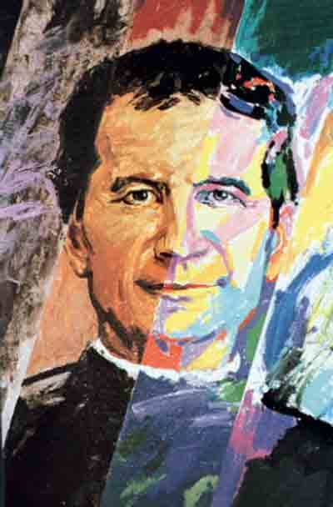

St John Bosco
Founder of the Salesian Family
Saint of Young People

Slide 3
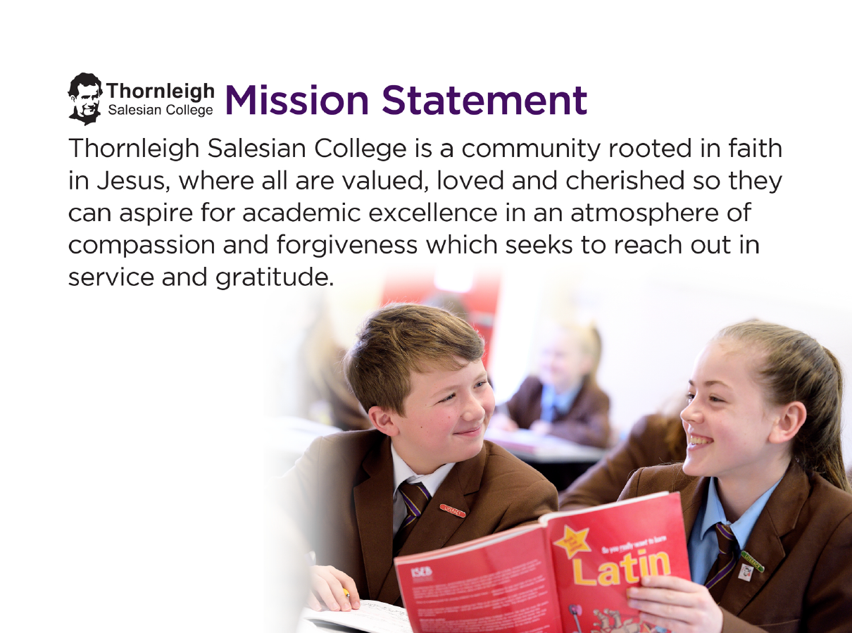

Slide 4


Slide 5

“The best blessing a child can receive is the awareness of being loved!” A sense of belonging comes from being loved.
Don Bosco’s Oratory Model
“Be happy, do good and leave them room to play.”
Home
Belonging
School
Learning
Church
Meaning
Playground
Celebrating
God Centred
Vocation at the heart
Salesian Presence
The simple act of being without intent.
“I have dedicated my whole life to young people, convinced that the future of a nation depends on their education.”
“The love of God knows no limits and excludes nobody, no matter what they do or what they believe.”

Slide 6
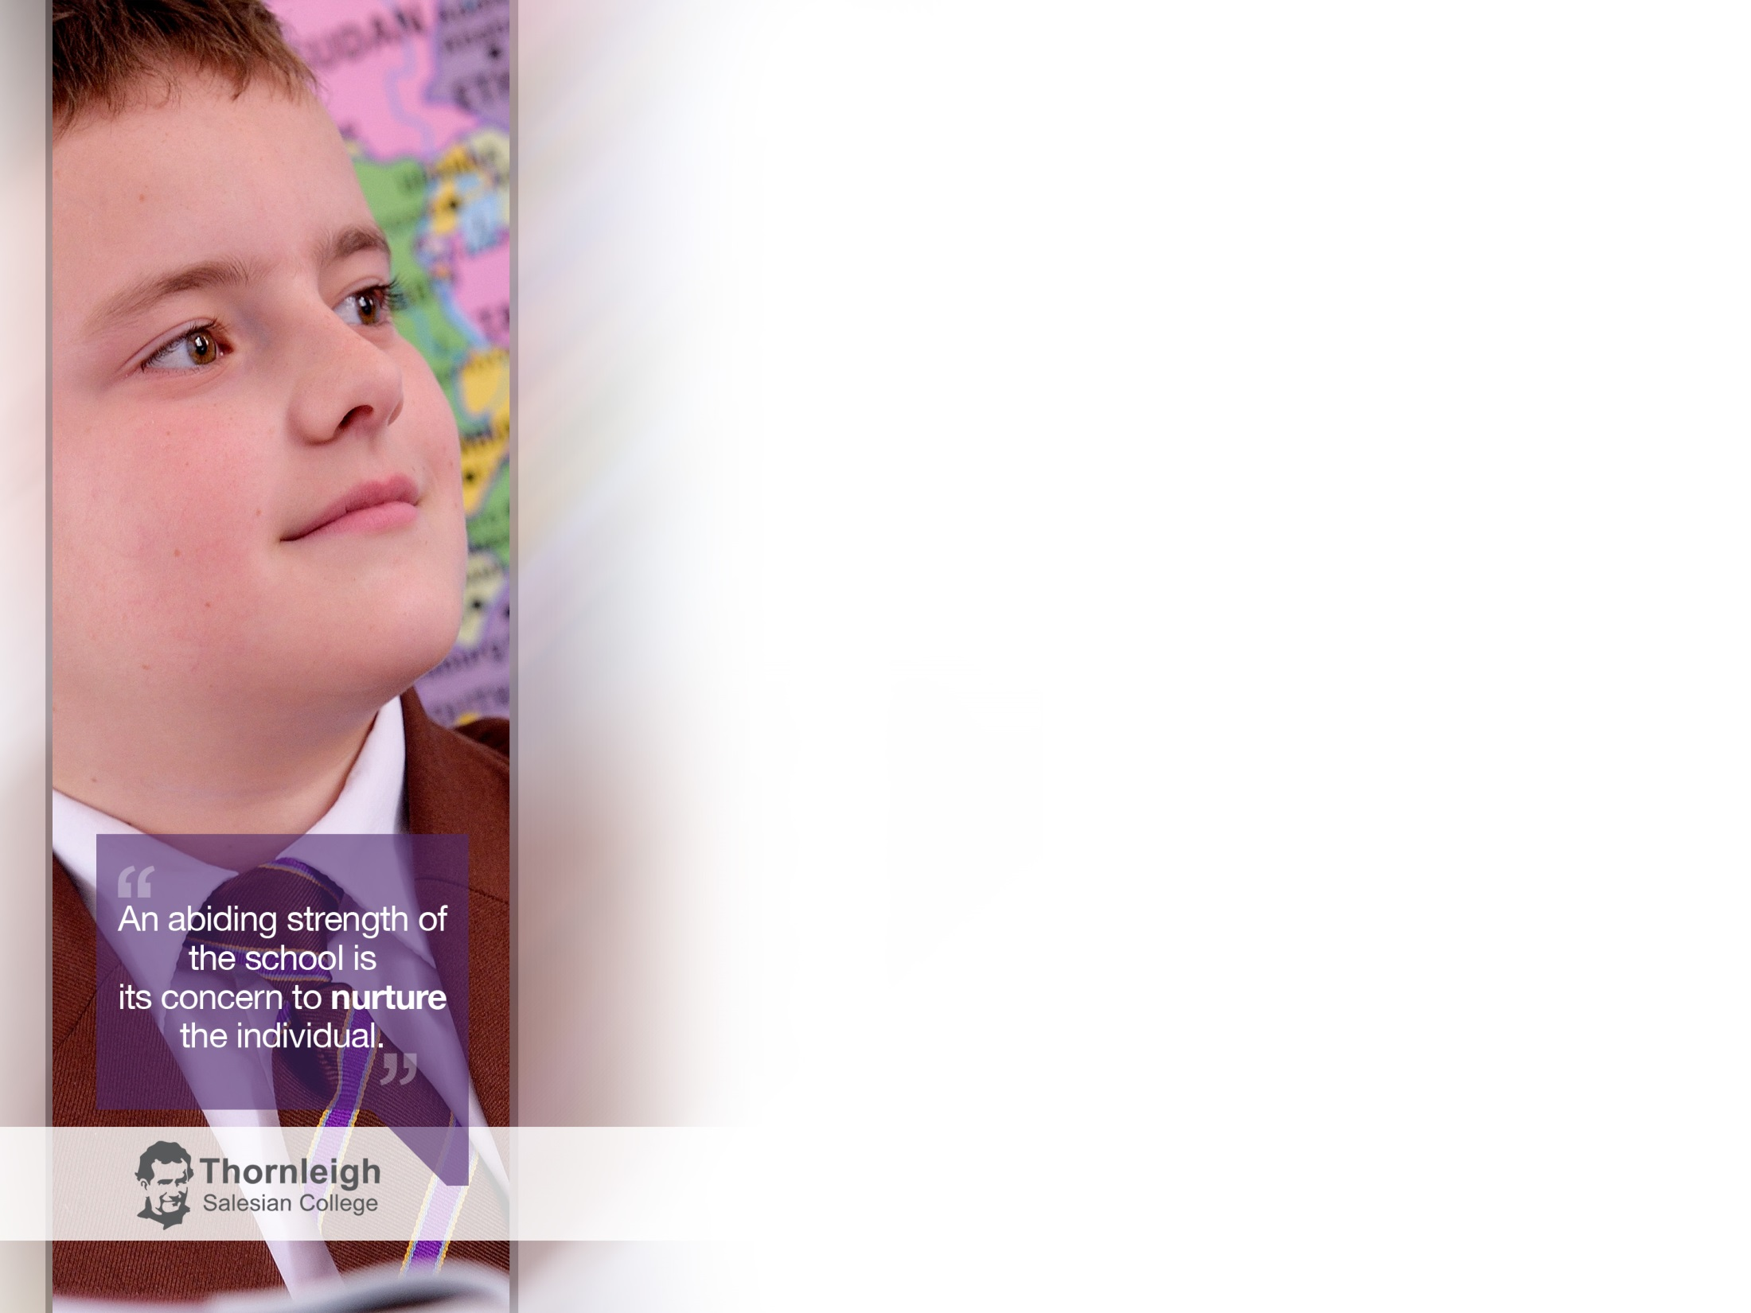
HOME – a place where;
All are welcomed
There is a real sense of belonging
They have responsibility and can play an active part
They are trusted and respected
Accepted as they are, broken or whole
Not turned away when they make a mistake
The creation of a truly family spirit was the foundation of his approach to education
Inclusive
No alternative education provision
Care, Guidance and Support structure
Restorative Justice
National and International network

Slide 7
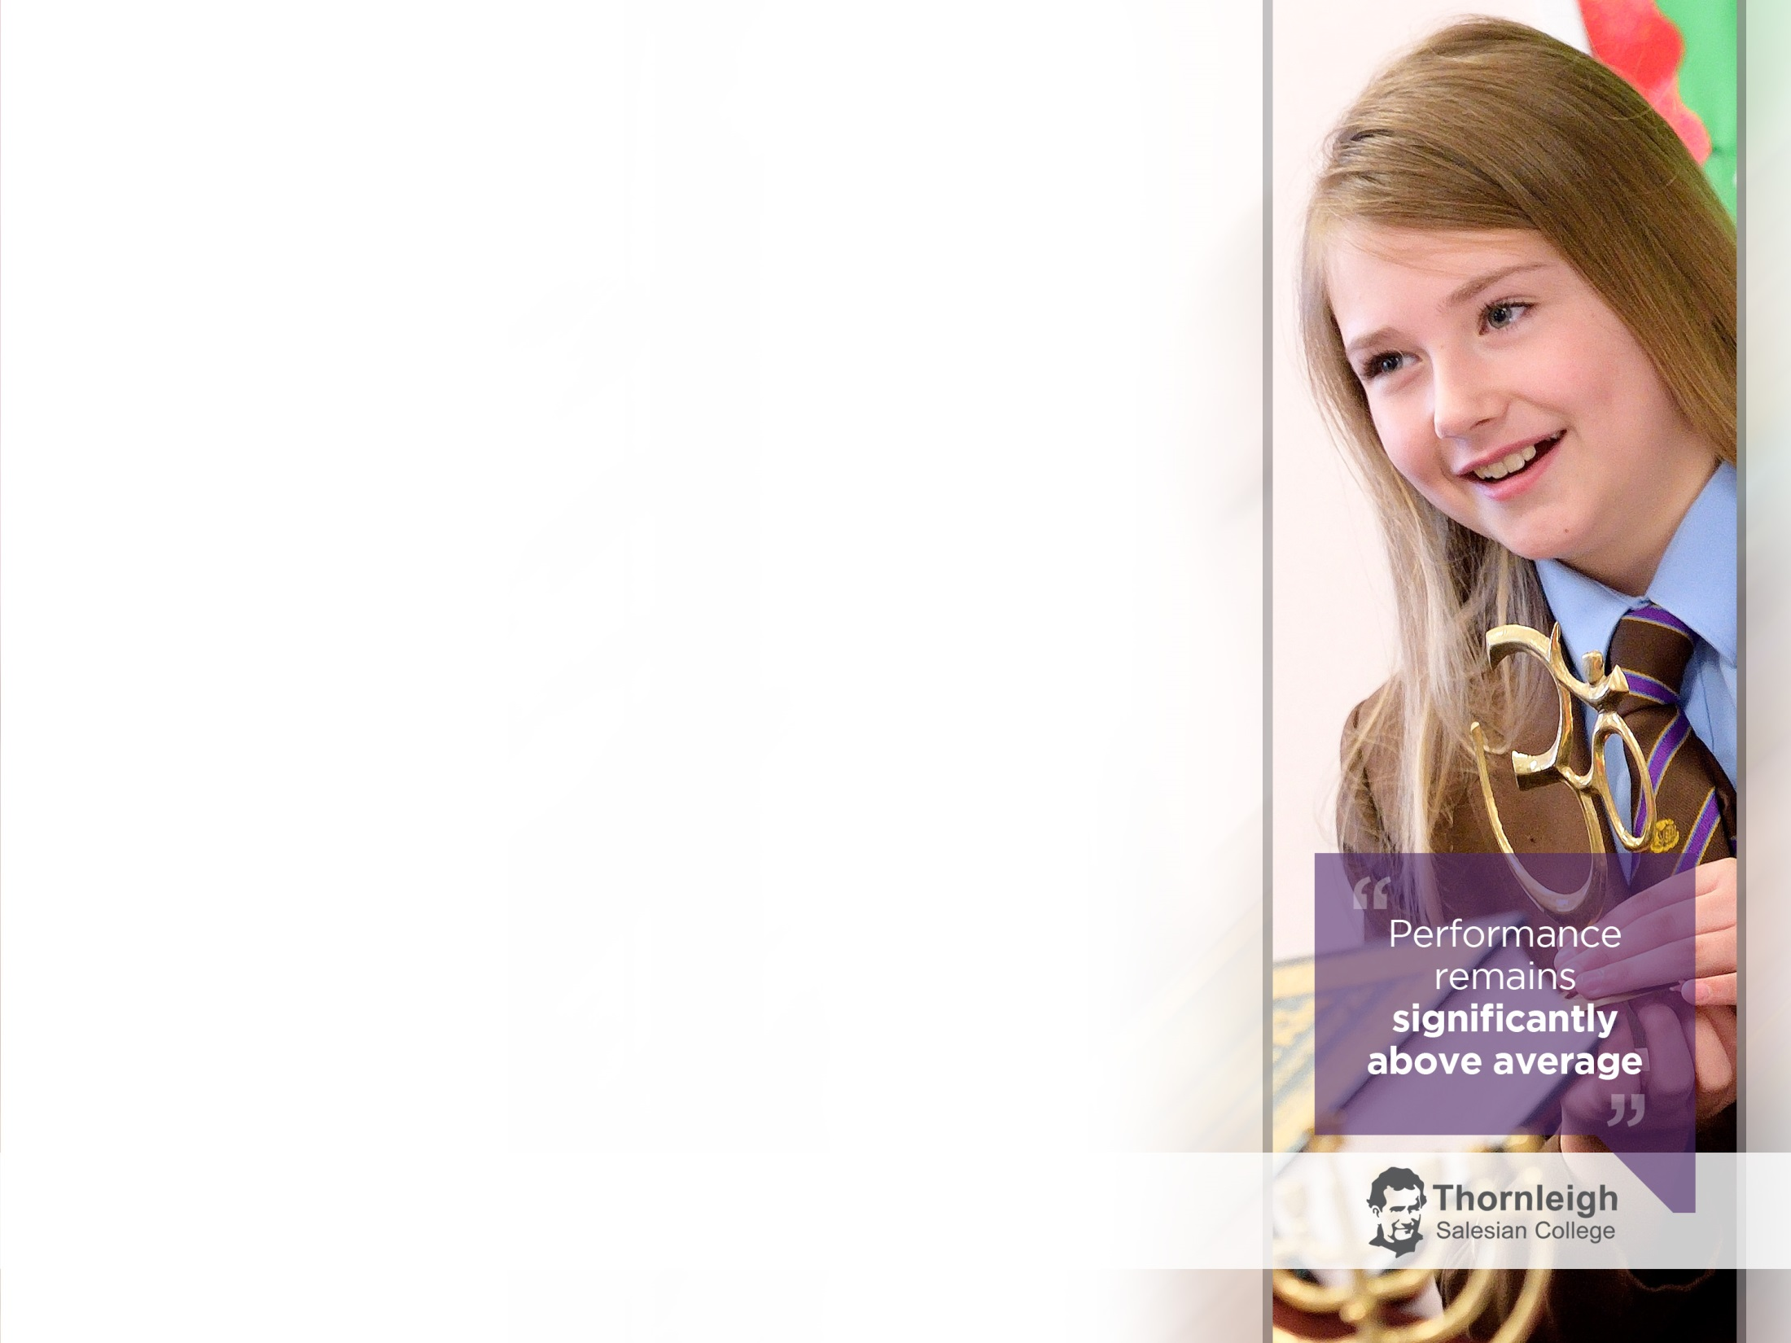
School – a place which;
Prepares young people for life and duties
Gives them the necessary academic and technical resources to enable them to be ‘honest citizens’
40% in 2009 – 75% 2016 with 0.41 Progress 8
Recruitment of staff who fully support the Salesian ethos of our school
School Council
SMART behaviour policy
Rewards and Consequences
Nurture provision
Bosco Centre
Appropriate pathways
‘Judge us on the way we meet the needs of our most vulnerable student’

Slide 8
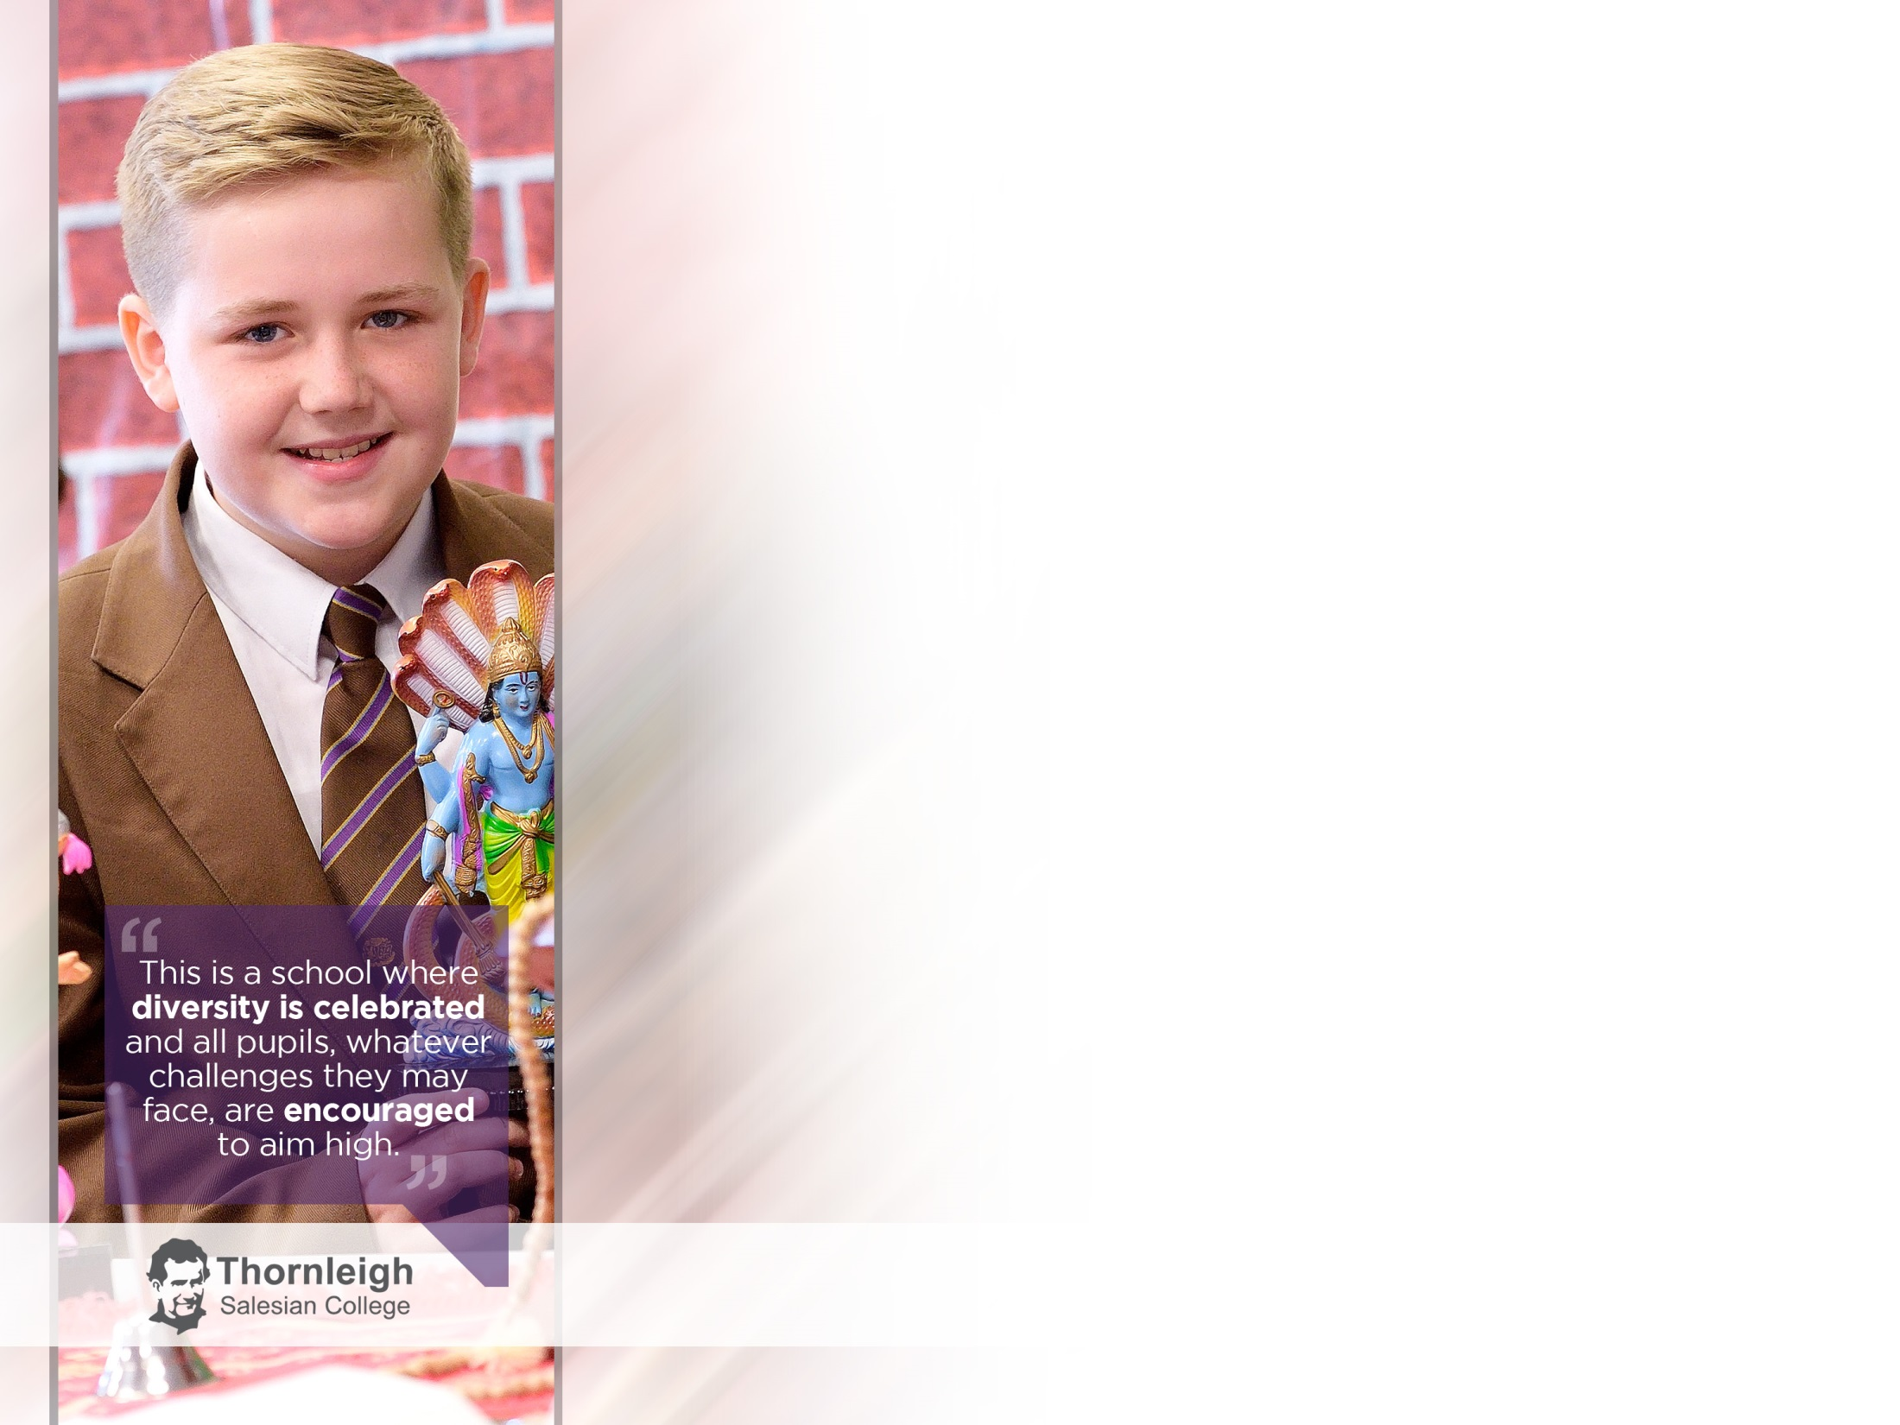
PLAYGROUND – a place where;
With friends and companions they can have fun and be joyful
Young people can be themselves
Relationships are formed between each other and with their educators
Relationships between staff and students
School holidays abroad
Retreat programme
Feast Day
Extra curricular programme

Slide 9
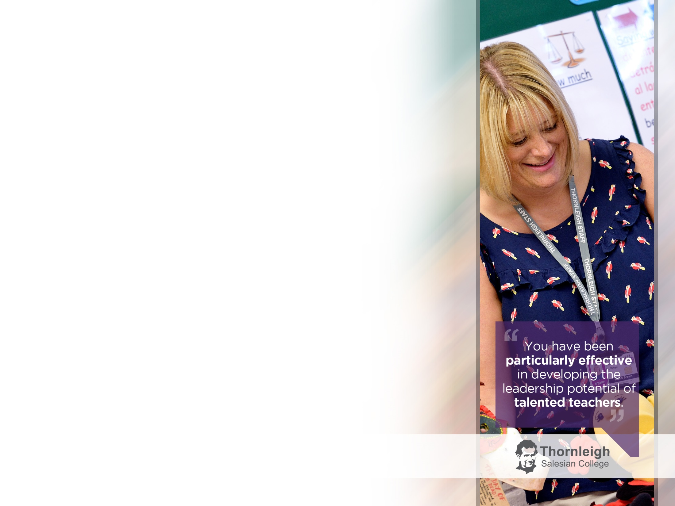
CHURCH -a place where;
God can be worshipped in joyful, youthful services
There is time for reflection on values and beliefs
Consideration is given on what is important in life and of being a service to others, especially those most in need
They are helped to be good Christians and mature into good people
Chaplaincy
Mission Week
Weekly mass
Christmas and Easter liturgies
Fundraising
Sacrament of reconciliation
Ash Wednesday
Tanzania

Slide 10
TASK 1
A: What do you understand by the blending of the elements of home, school, church and playground?
B: As senior leaders, how are you facilitating home, school, church and playground so that you can achieve your mission statement?

Slide 11
How do the staff body in our school know that they are loved?

Slide 12

The Preventive* System
(*Preventive is far richer than preventative.
It means the ability to step ahead of people, reading their needs before they become aware of them)
At the heart of the Preventive System is;
Being present in their midst
Assistance
Accompaniment
Standing with staff
Walking with staff with real affection
Wasting time with each other
R.U.A.H
Respect Understanding Affection Humour

Slide 13
TASK 2
As senior leaders, what are you doing/what can you do to promote the RUAH values in your schools so that they can be caught by everybody?

Slide 14
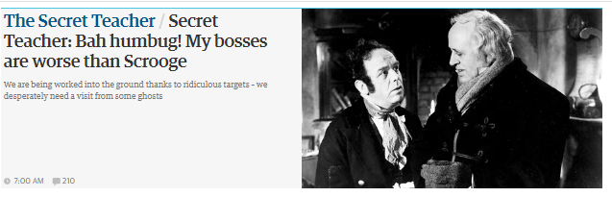
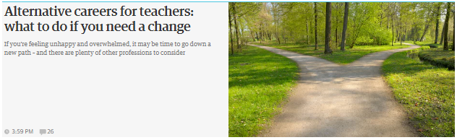

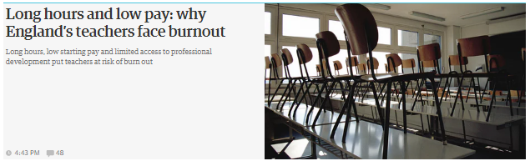
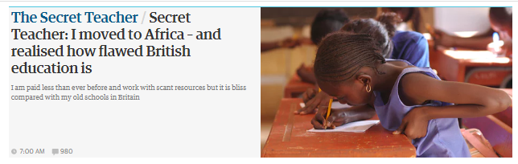
Chris Bingley
Thornleigh Salesian College 2006 (NQT) – Present
Teacher of PE
Continued Professional Development & Learning (CPDL) and KS2-KS3 Leader
Affection & Humour =
Affection & Humour =
JOY
Joy!
Well-being!
Flourishing!

Slide 15
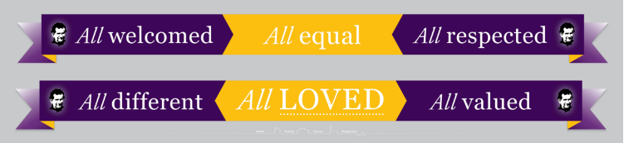
Understanding
Noun
1: A state of cooperative or mutually tolerant relations between people

Slide 16
TASK 3
How do you work together as senior leaders to enable your mission statement to permeate everything that you do to drive improvement?

Slide 17

Understanding
Noun
1: A state of cooperative or mutually tolerant relations between people
Bring the mission statement to life and make it clear to staff that:
They are valued, loved and cherished so they can aspire for
academic excellence as part of the CPDL Programme.

Slide 18
Respect
Noun
1: Providing a range of choices for staff
2: Manifestation of the excellent personal abilities of the staff
3: Providing opportunities for admiration to be felt or shown to someone or something that you believe has good ideas or qualities.
Learning Support Team:
Questioning and scaffolding
LSA student feedback
Intervention evaluation feedback
Pastoral Leaders:
The language of post-incident analysis.
Teachers:
Increased rigour of linear exams with a particular focus on literacy
Increased demand on students to retain knowledge in linear exams.
Strategies to stretch and challenge disadvantaged students.
Teaching and learning strategies in response to ‘life without levels.’

Slide 19
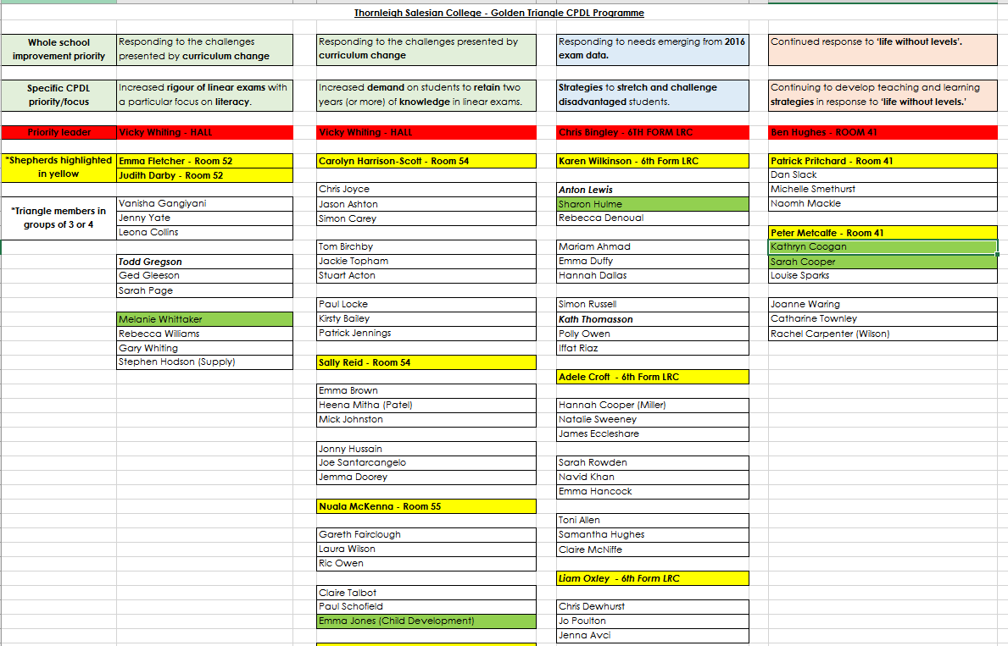
Respect
Noun
1: Providing a range of choices for staff
2: Manifestation of the excellent personal abilities of the staff
3: Providing opportunities for admiration to be felt or shown to someone or something that you believe has good ideas or qualities.

Slide 20
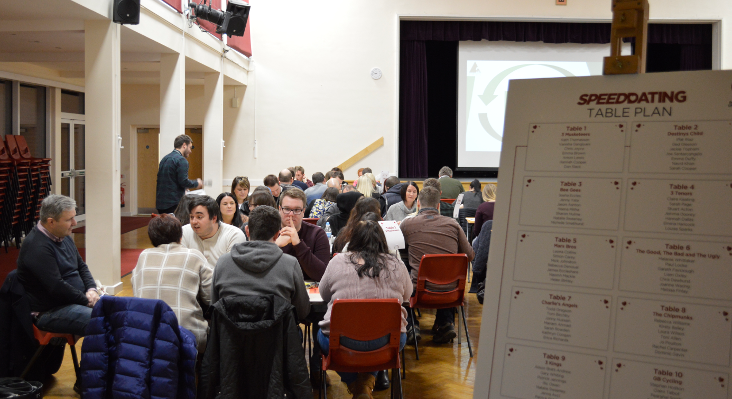
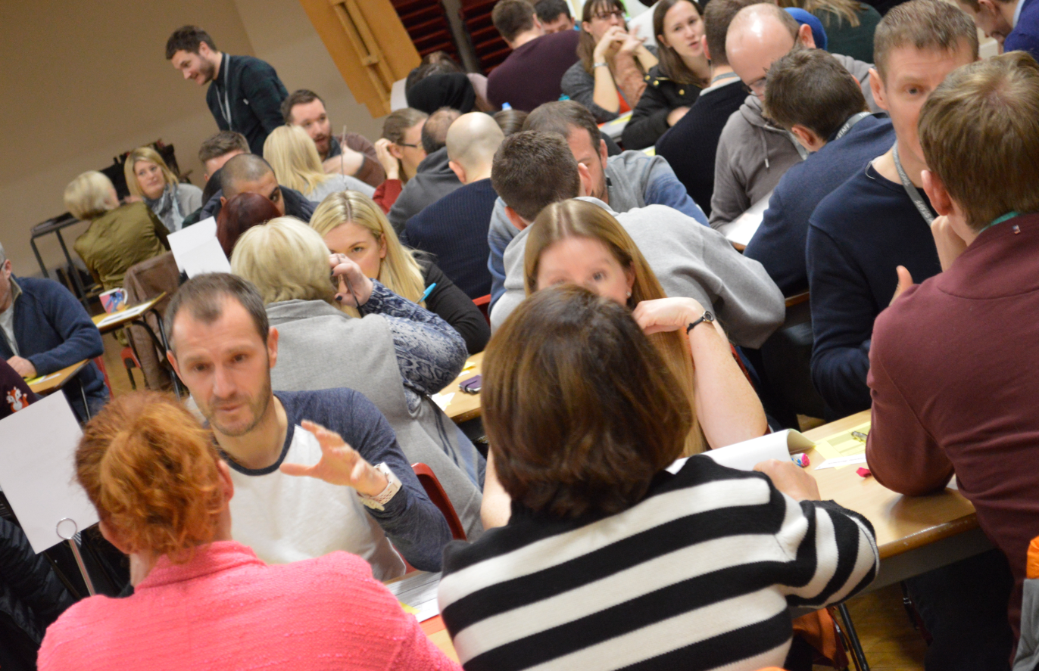
Respect
Noun
1: Providing a range of choices for staff
2: Manifestation of the excellent personal abilities of the staff
3: Providing opportunities for admiration to be felt or shown to someone or something that you believe has good ideas or qualities.

Slide 21
TASK 4
By considering Home, School, Church and Playground alongside the principles of RUAH; evaluate the different body members/parts that you lead in your school and think of the opportunities that you could present them with in the future to help you achieve your mission/common purpose.

Slide 22
A tradition cannot survive by simply being talked about. It can only survive by men and women being found that will enter into that tradition. That tradition has to be recreated in every generation. We recreate it by discovering it in our own experience.
It is a living tradition and by living, it possesses power.
It is a living flame that has the power to enlighten, to guide and to warm.
Those responsible for the tradition must
Cherish it
Critique it
Contribute to it
Communicate it
Celebrate it

Slide 23

THE RESULT FOR US?
“Staff share a unity of purpose and an uncompromising drive for further improvement.”
Joan Bonenfant, HMI OFSTED, January 2016
THE OUTCOME???

Slide 24
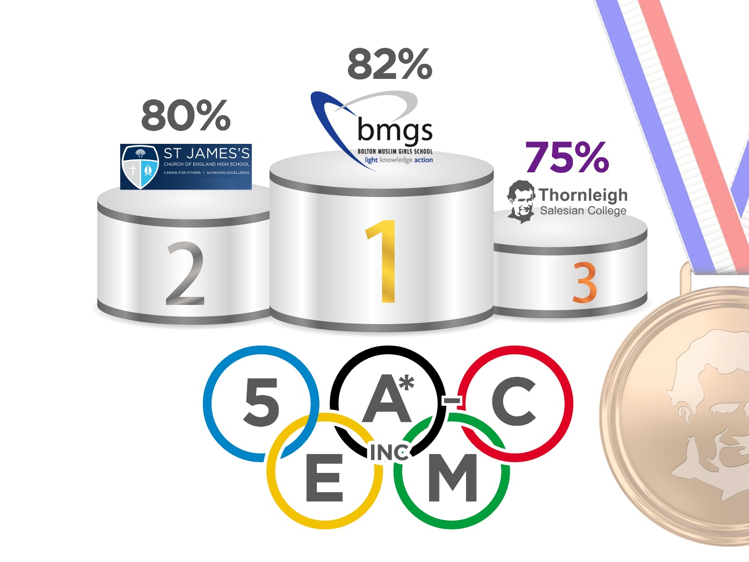

Slide 25

Bronze
3rd Highest Performing School in Bolton
All students 5 A*-C inc. EM
Boys 5 A*-C inc. EM
Boys Basics
Boys A*-C in Science
All students A*-C in English
Boys 5 A*-C

Slide 26

Silver
2nd Highest Performing School in Bolton
All students Progress 8
All students Attainment 8
Boys Attainment 8
Boys EBacc achieved
Girls Progress 8
All students Basics
All students 5 A*-C
Girls A*-C in Maths
All students A*-C Science

Slide 27

Gold
HIGHEST Performing School in Bolton
Boys 4 LoP in Maths
Boys Progress 8 (+0.35, 2nd = +0.10)
All students 3 LoP in English
Girls Attainment 8
Girls Basics
Girls 5 A*-C EM
Girls 5 A*-C
Girls A*-C in English
Girls A*-C in Science
Girls A*-C in Humanities
Girls 3 LoP in English
Girls 3 LoP in English and Maths
Girls 4 LoP in English
Girls 4 LoP in English and Maths

Slide 28
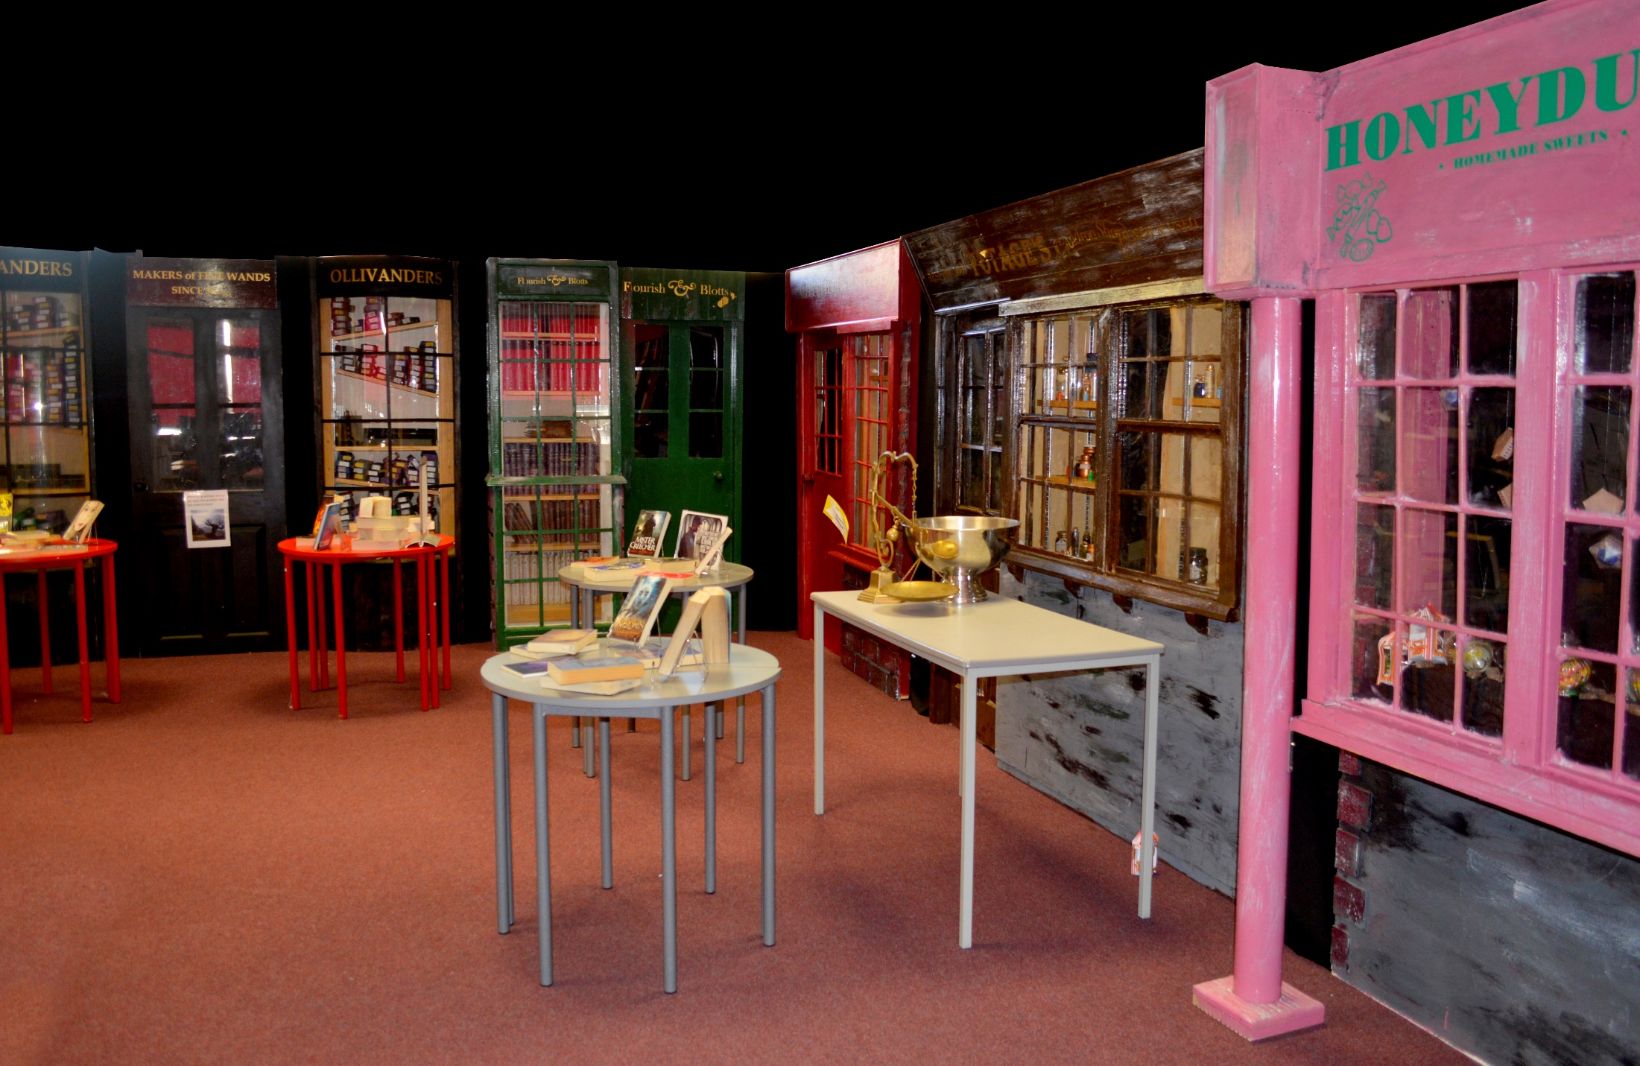

Slide 29
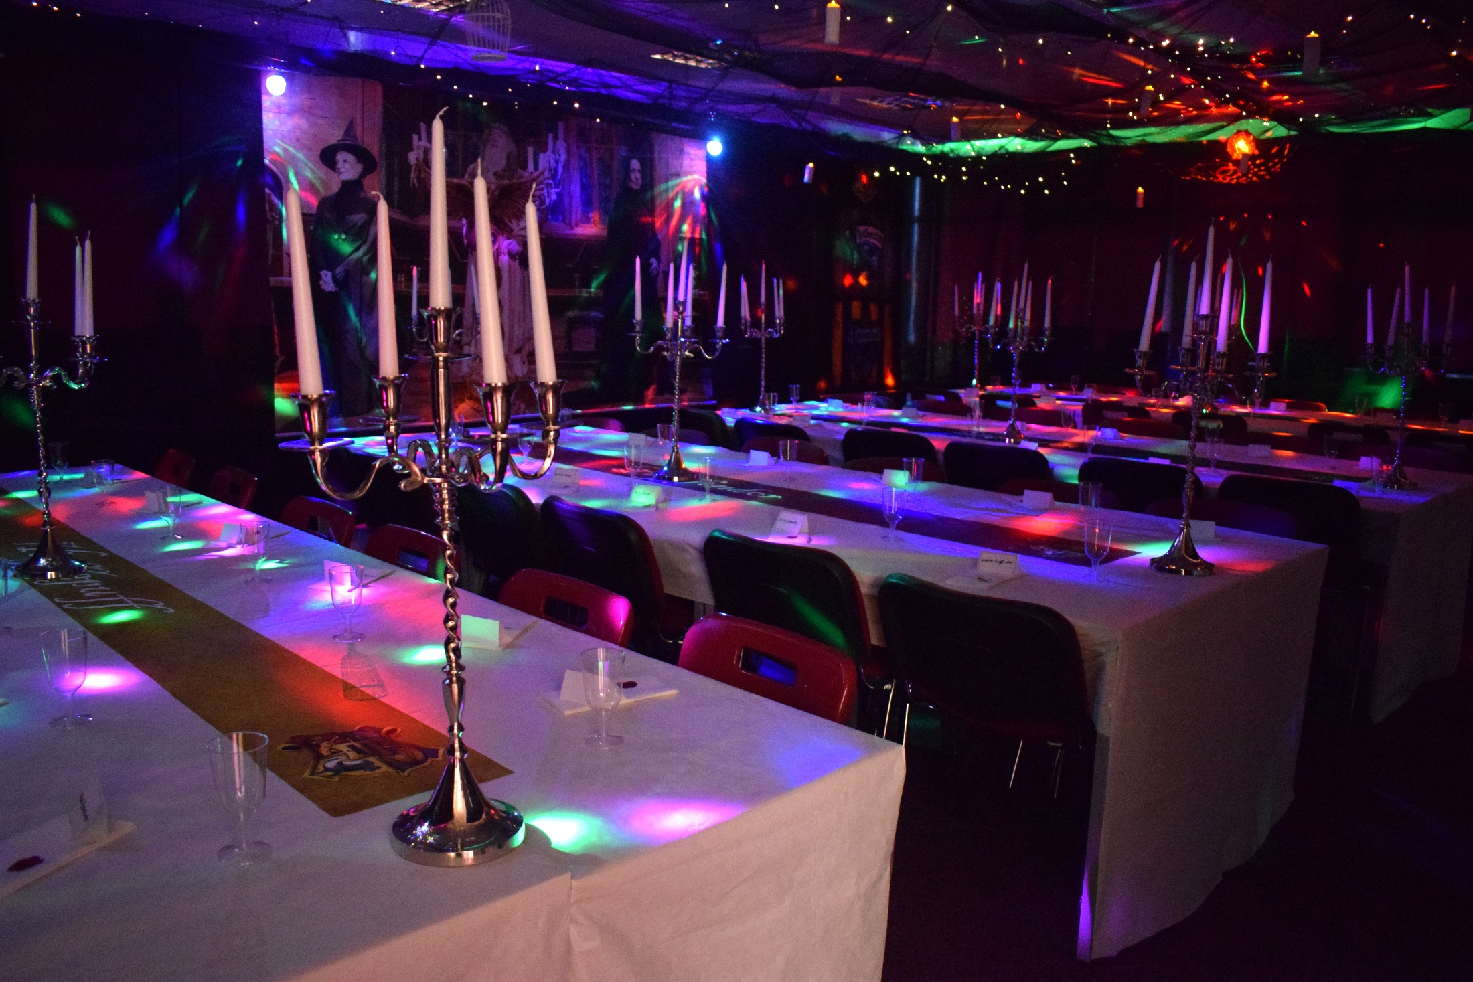

Slide 30
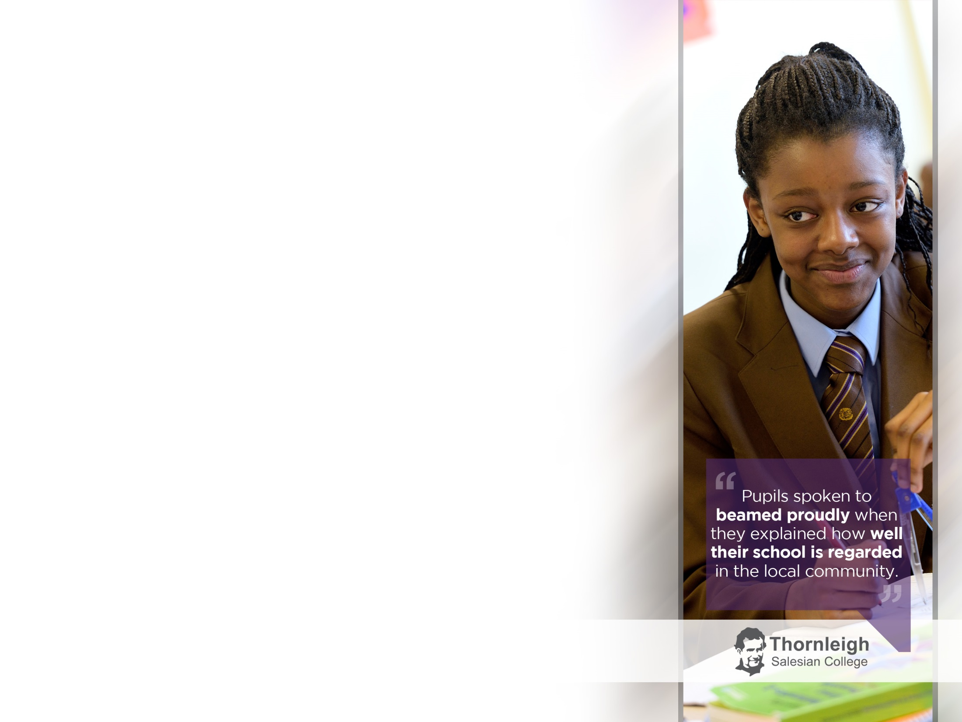
What do you find most attractive in Don Bosco’s system of education?
What do you think might be most difficult to put into practice for teachers? Why?
Would you say that your school was more ‘preventive’ than ‘repressive’ in its ethos and discipline?
What do you understand by the blending of the elements of home, school, church and playground? How do they play a part in the education provided in your school?

