Slide 2
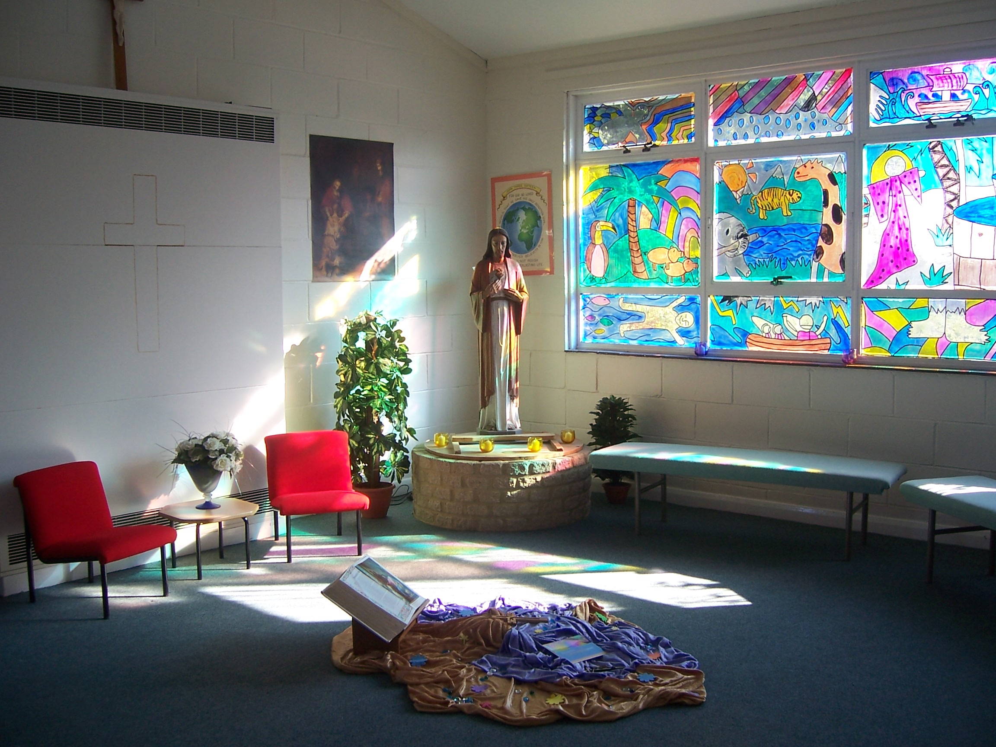
Chaplaincy
Some reference points
For Catholic Clergy

Slide 3

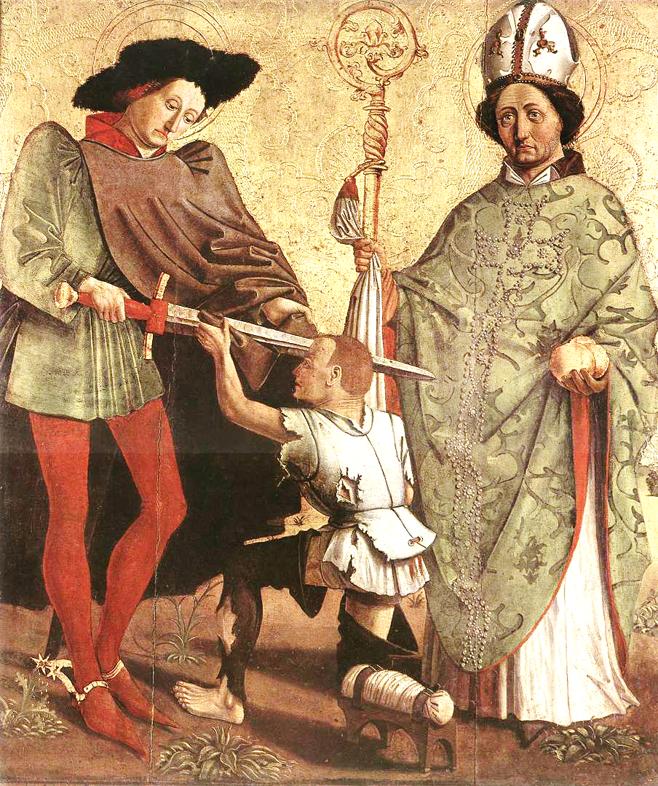
History
It was inspired by a lay person’s act of listening and serving the needy.
It is based around the God given dignity of each person in the community
It is a form of service that challenges others to think about their own lives.
It involves safeguarding and celebrating the spiritual treasures of a community
It is a ministry rooted in prayer and reflection Jesus and the Gospels

Slide 4

Canon Law
Can. 564 A chaplain is a priest to whom is entrusted in a stable manner the pastoral care, at least in part, of some community or special group of Christ's faithful, to be exercised in accordance with universal and particular law.

Slide 5
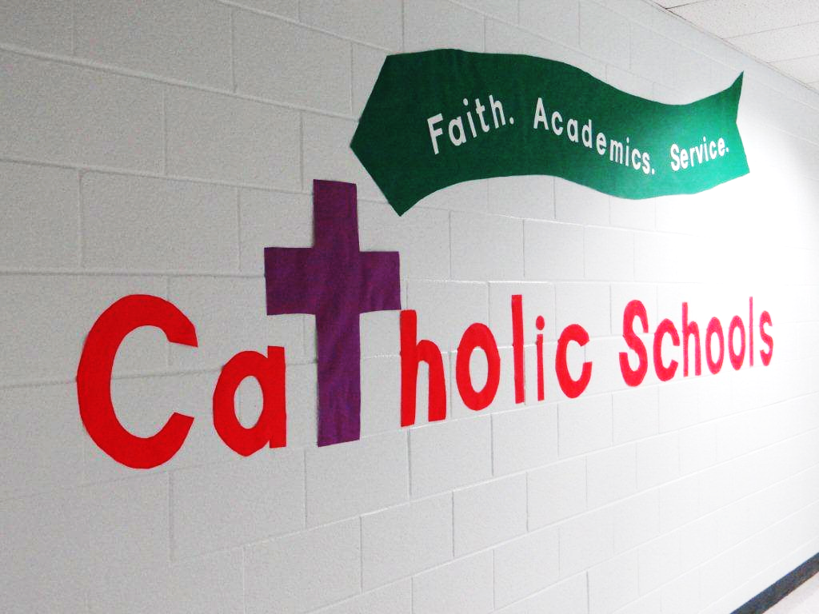
Nature of a catholic school
Catholic school is a place of integral education of the human person through a clear educational project of which Christ is the foundation; it’s ecclesial and cultural identity; its mission of education as a work of love; its service to society; the traits which should characterize the educating community.
The Catholic School on the threshold of the new millennium (4)

Slide 6

Catholic Youth Ministry
Goal A
Youth ministry fosters the complete personal and spiritual growth of each young person, acknowledging their specific needs in our society.
Goal B
Youth ministry calls young people to live as disciples of Jesus Christ in the world today, rooted in the living tradition of church/
Goal C
Youth ministry enables young people to participate fully in the life of the Catholic community, recognizing the intrinsic value of youth and all that it has to offer the church.
Goal D
Youth Ministry sends young people out as prophetic witnesses of Christ, calling the world and the church to a renewal of faith, hope and love.
Department of Evangelisation and Catechesis CBCEW available on CYMFED web site resources

Slide 7

New Evangelisation
Evangelization as a regular activity of the church, a lifelong process directed at practicing Catholics;
The mission ad gentes, meaning the first proclamation of Christ to non-Christian persons and peoples;
"New Evangelization," meaning outreach to baptized Catholics who have become distant from the faith.

Slide 8
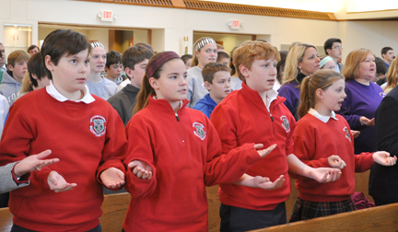
Liturgical Norms
The celebration of the liturgy in school is governed by the general instructions of the roman missal. But in a context where most of the participants are young and many are unused to regular celebration of the Eucharist other guidelines need to be taken into account. The key document is the directory on children’s masses. The diocese of Leeds points out in its own directory that the children’s directory can also apply to youth..
http://www.dioceseofleeds.org.uk/education/files/GuidelinesforCelebratingSchoolMassesFinalRevisedTextApril2011.pdf

Slide 9

Inspection Frameworks/ Evaluation
Diocesan inspection fulfils both the canonical and statutory responsibilities of the Bishop with regard to all schools and colleges in his Diocese. • Diocesan school inspection seeks to support and promote an authentic Catholic vision of education. This education inspires and enables the development of children and young people within the context of a real partnership between home, school and parish.

Slide 10

Contracted teachers
3.1 You are to exercise the ministry of a teacher in the School under the directions of
(a) the Governing Body and
(b) the immediate directions of the head teacher and in accordance with;
(c) the Trust Deed and the Instrument of Government in force for the School;
(d) Canon Law in relation to the governance of the School;
(e) any regulations or policies of the Governing Body;
3.2 You are expected to be conscientious and loyal to the aims and objectives of the school.
3.3 You are to have regard to the Christian character of the School and not to do anything in any way detrimental or prejudicial to the same.

