Slide 1

WELCOME BACK TO SCHOOL
2018 - 2019

Slide 2
School Mission Statement
We aim to provide an education based on:
Respect: To show respect for ourselves, for others and towards God. Our tolerance is key to living out our respect of the choices made by others and their own deeply held beliefs. To respect the value of education.
Understanding: To understand that we have all been created in the image of God and how that shapes the way we treat each other. To develop lively, enquiring minds that are continually challenged to seek knowledge and develop our skills and talents for our own benefit and that of the wider community.
Affection: To strive to develop a deep affection for all of God’s creation and to learn to recognise His Hand in it all and His Face in everyone. To ensure that our school community is built on positive relationships.
Humour: To serve the Lord with holy cheerfulness and to share the joy and optimism of the Gospel in our daily lives.
As a Salesian School, we recognise that we are all supported and blessed in our lives by the prayers of all those in our school as well as Mary Help of Christians and St John Bosco.
Thank you to the School Council members who articulated our school mission for us
December 2017

Slide 3

This affects everything
that we
do in school;
how we think and behave;
how we
work together and treat
each other

Slide 4

SJBC School Council decision: December 2017
School Rules
=
R U A H

Slide 5

These are our school rules:
We do everything with respect for ourselves and others and our community
We understand our differences and needs; we consider these in how we behave. We value the power of understanding and knowledge.
We treat each other with affection showing our care for those around us, our community and world
We approach each other with good humour; kindness and gentleness – treating others how we would want to be treated ourselves.

Slide 6

What does that look like?
RESPECT
  We respect everyone’s right to learn and do well; we don’t distract or disturb our own learning or that of others.
We respect everyone’s right to speak and listen to each other
We respect each other’s right to focus on education: mobile phones and other personal electronic devices should not been seen or heard in school
  We are all equal and part of the school community; we show this through wearing our school uniform correctly and with pride. We remember that we represent the school at all times including when travelling to and from school.

Slide 7
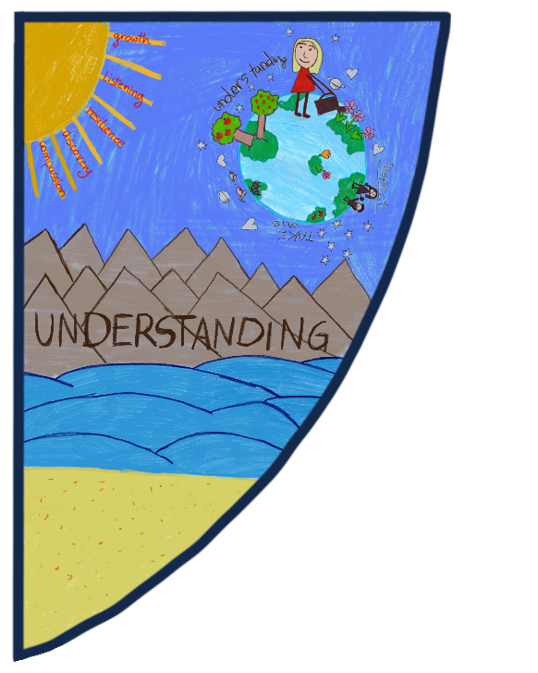
What does that look like?
UNDERSTANDING
  We understand that we all have a responsibility to create a safe and calm environment for each other: we move purposefully and calmly around the school and treat the building and its environment with consideration. We respect other’s personal space and do not ‘play-fight.’
We understand that our focus is learning and education: mobile phones should not be
  We understand that we achieve our best when we work together: Governors-Teachers-Students and Parents.

Slide 8
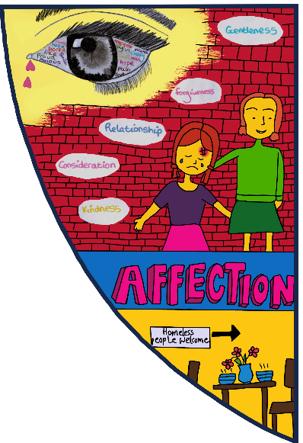
What does that look like?
·
AFFECTION
  We treat each other as we would like to be treated: we speak politely, with kindness and care
We are helpful and thoughtful to everyone we encounter
We show our affection and respect for each other by what we say and what we do.
We remember that every person is valuable and special and so we treat others with tolerance and patience; we do not tolerate bullying or unkindness.

Slide 9

What does that look like?
HUMOUR
  We are positive and optimistic; we learn from mistakes and difficulties and learn how to be resilient and confident.
  We always remember that lesson time is learning time: we never stop others from learning and from feeling safe and happy in school
We work on managing our emotions and always consider how we make those around us feel.

Slide 10


Half-term Circle Time
Learning to listen to each other

Slide 11

Starting from Don Bosco

Slide 12
Year seven to use the board with additional tokens, positive and negative
Year Eight and Nine to use a variation involving a more detailed paper exercise- Four squares and a diamond.
Year 10 and 11 to explore the basic pattern from the first experience but in the shorter time scale of fifty minutes
Sixth form to follow a speed dating type model for listening to each other.

Slide 13
Year Seven
A Harry Potter link
The teacher will lead the group in collecting memories from the half term.
Will have two tokens to play on the board, one positive and one negative.
The array can be looked at and some basic questions asked

Slide 14
Year Seven
Where are the most happy faces?
Which section seems the most positive?
Why might that be?
Say, “I wonder whether the positive smiley faces are all about the same things?”
Invite individuals to name a positive thing and point to it on the display
The teacher will lead the group in collecting memories from the half term.

Slide 15
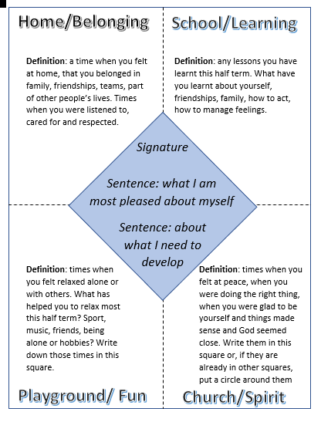
Year eight
and nine

Slide 16
4 Squares and a diamond
Starts with a slow process of paper folding
Creating a focus on the paper – making a promise to write the truth.
Guiding the class through each section: Teacher to model an example for each square.
Belonging for me meant--- story, feeling, music, a story title.
I wonder what your memory is of ..belonging/ learning/ relaxing/ being at peace
Draw or write your response on the paper
Quiet music………
Year eight
and nine

Slide 17
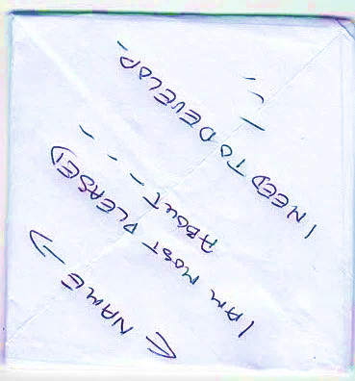
4 Squares and a diamond
Year eight
and nine

Slide 18
4 Squares and a diamond
Sharing sequence
Talk in pairs or small groups about what they have written on the diamond
After a short time gather the class together and ask them to reflect back some of the good things they have heard
Ask if anything has come up that needs to be shared with the schools council or leadership.
Finish with a prayer and a treat
Year eight
and nine

Slide 19
Speed rating
Purpose:
To create a light touch friendly but brief contact with others in the tutor group with which memories and experience can be shared.
Sixth Form

Slide 20

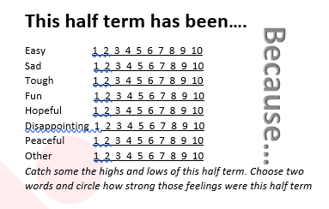
Speed rating
Sixth Form

Slide 21
Speed rating
Sixth Form
Students ideally in a circle where people can move in one direction to their next partner for sharing

Slide 22
Speed rating
Timings:
Minutes to talk
2 Minutes to listen
Minute to change to a new partner
Probably seven pairs can share…
Sixth Form

Slide 23
Speed rating
Wrap up questions:
Was that easy or a bit weird?
Did two minutes seem too long or too short?
Without saying anything specific, did you learn anything new about each other? (ask for a show of hands)
Do you think this kind of listening could help us learn better? Why or why not?
Sixth Form

Slide 24
Speed rating
Ending reflection
The half term is nearly at an end.
Another slice of school life is almost over.
May I find my pathway through all that has happened:
In my study and in my hopes for qualifications.
In my friendships and how they are growing and changing.
In the way I see myself, my gifts and my weaknesses.
I know that men and women become wise by reflecting on experience.
May I become a wiser person through thinking about my half term.
Let the patterns of my life emerge from my memories and into meanings
So that I can see my gifts and avoid repeating mistakes
And have a great compassion for myself and for those I have listened to today.
I ask this from the depth of my heart and from the mystery of life that many people call God.
AMEN
?
Sixth Form

Slide 25
Salesian Circle Time
?

