Slide 1
School Chaplaincy
SOME REFERENCE POINTS FOR LEADERSHIP

Slide 2
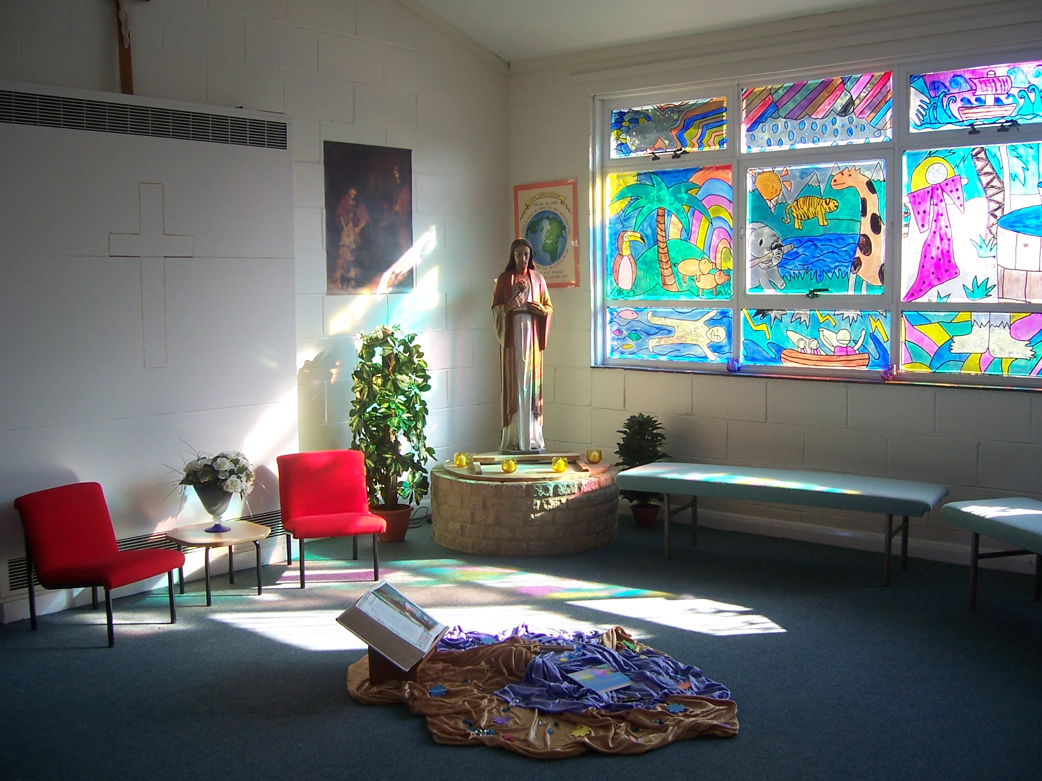
Chaplaincy
Some reference points
For School Leaders

Slide 3
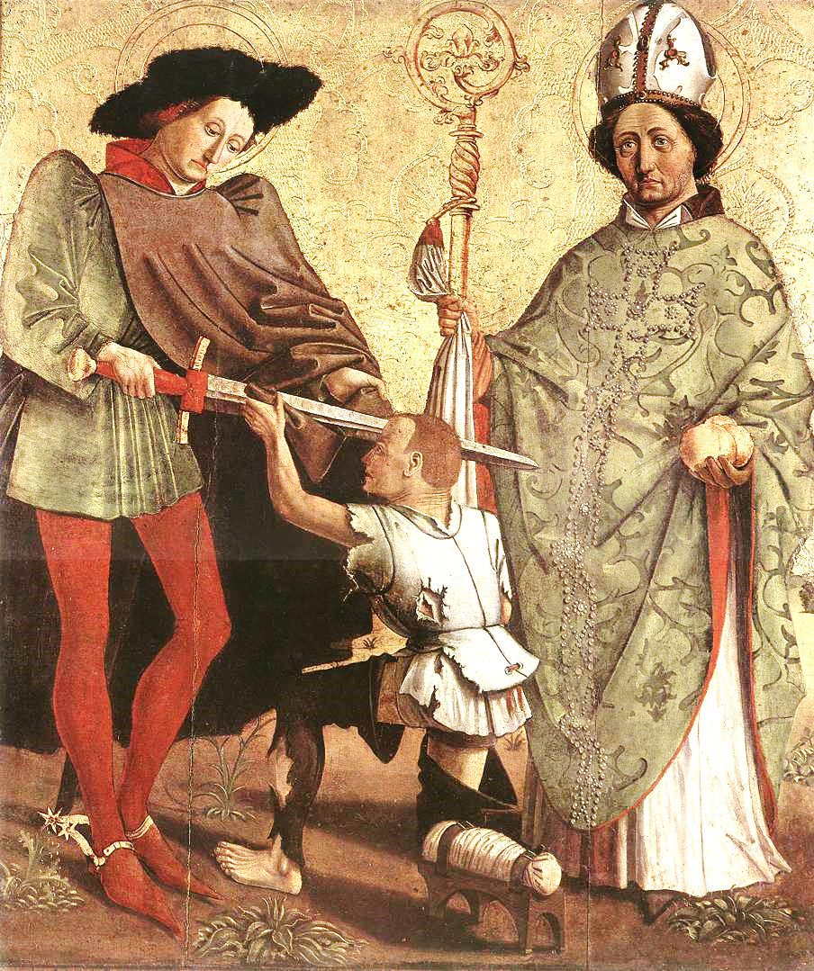
History
It was inspired by a lay person’s act of listening and serving the needy.
It is based around the God given dignity of each person in the community
It is a form of service that challenges others to think about their own lives.
It involves safeguarding and celebrating the spiritual treasures of a community
It is a ministry rooted in prayer and reflection Jesus and the Gospels

Slide 4
Canon Law
Can. 564 A chaplain is a priest to whom is entrusted in a stable manner the pastoral care, at least in part, of some community or special group of Christ's faithful, to be exercised in accordance with universal and particular law.

Slide 5
Nature of a catholic school
Catholic school is a place of integral education of the human person through a clear educational project of which Christ is the foundation; it’s ecclesial and cultural identity; its mission of education as a work of love; its service to society; the traits which should characterize the educating community.
The Catholic School on the threshold of the new millennium (4)

Slide 6
Catholic Youth Ministry
Goal A
Youth ministry fosters the complete personal and spiritual growth of each young person, acknowledging their specific needs in our society.
Goal B
Youth ministry calls young people to live as disciples of Jesus Christ in the world today, rooted in the living tradition of church/
Goal C
Youth ministry enables young people to participate fully in the life of the Catholic community, recognizing the intrinsic value of youth and all that it has to offer the church.
Goal D
Youth Ministry sends young people out as prophetic witnesses of Christ, calling the world and the church to a renewal of faith, hope and love.
Department of Evangelisation and Catechesis CBCEW available on CYMFED web site resources

Slide 7
New Evangelisation
Evangelization as a regular activity of the church, a lifelong process directed at practicing Catholics;
The mission ad genets, meaning the first proclamation of Christ to non-Christian persons and peoples;
"New Evangelization," meaning outreach to baptized Catholics who have become distant from the faith.

Slide 8
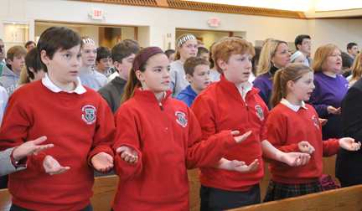
Liturgical Norms
The celebration of the liturgy in school is governed by the general instructions of the roman missal. But in a context where most of the participants are young and many are unused to regular celebration of the Eucharist other guidelines need to be taken into account. The key document is the directory on children’s masses. The diocese of Leeds points out in its own directory that the children’s directory can also apply to youth..
http://www.dioceseofleeds.org.uk/education/files/GuidelinesforCelebratingSchoolMassesFinalRevisedTextApril2011.pdf

Slide 9
Inspection Frameworks/ Evaluation
Diocesan inspection fulfils both the canonical and statutory responsibilities of the Bishop with regard to all schools and colleges in his Diocese. • Diocesan school inspection seeks to support and promote an authentic Catholic vision of education. This education inspires and enables the development of children and young people within the context of a real partnership between home, school and parish.

Slide 10
Contracted teachers
3.1 You are to exercise the ministry of a teacher in the School under the directions of :
(a) the Governing Body and
(b) the immediate directions of the head teacher in accordance with;
the Trust Deed and the Instrument of Government for the School;
Canon Law in relation to the governance of the School;
Any regulations or policies of the Governing Body;
3.2 You are expected to be conscientious and loyal to the aims and objectives of the school.
3.3 You are to have regard to the Christian character of the School and not to do anything in any way detrimental or prejudicial to the same.

Slide 11
Chaplaincy – a charter statement?
This is what is needed: a Church for young people, which will know how to speak to their heart and enkindle, comfort, and inspire enthusiasm in it with the joy of the Gospel and the strength of the Eucharist;
a Church which will know how to invite and welcome the person who seeks a purpose for which to commit his whole existence;
a Church which is not afraid to require much, after having given much;
which does not fear asking from young people the effort of a noble and authentic adventure, such as that of the following of the Gospel.” (Pope John Paul II. 1995 World Day of Prayer for Vocations)

Slide 12
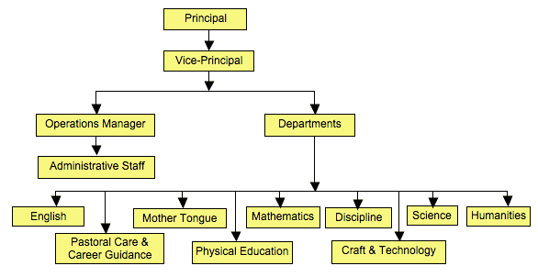
Chaplaincy where is it in your mind?
?

Slide 13
Chaplaincy – the content:
The Ministry of Advocacy | Defending, protecting and speaking for young people at risk within the community
The Ministry of Catechesis | Learning to use scripture, prayer and experiencing Christian life as expressions of a personal relationship with Jesus
The Ministry of Community | Building a sense of belonging and an identity that extends into a wider Church sharing of life and love
The Ministry of Evangelisation | To awaken a call to follow the Gospel and make a difference to our world especially by adult example discipleship
The Ministry of Justice and Service | To recognise the needs of the poor and oppressed and to start to respond with love and self-sacrifice
The Ministry of Leadership Development | To identify and encourage the gifts of leadership among the young through sharing decisions, practical roles and training
The Ministry of Pastoral Care | A community-based response to the needs of the young modelled as a form of Gospel love
Prayer and Worship | Bringing the lived experience of the school community into celebrations of Gospel faith, prayer and the sacraments of the church.
Multi-cultural working | Having a welcoming Gospel inspired focus to welcoming the stranger and building multi-cultural bridges into the local community.

Slide 14
Chaplaincy – the content:
The Ministry of Advocacy
The Ministry of Catechesis
The Ministry of Community
The Ministry of Evangelisation
The Ministry of Justice and Service
Leadership Development
The Ministry of Pastoral Care
Prayer and Worship
Multi-cultural working
Who does these roles now in your school community?

Slide 15
Chaplaincy: how is this thread managed?

Slide 16
Chaplaincy: how can it be structured?

Slide 17
Chaplaincy: how can it be structured?

Slide 18
Chaplaincy: how is it accountable?
Evaluating the shape of Chaplaincy
What aspects of youth ministry are present in the chaplaincy activities listed below? | Community building | Evangelisation | Justice and service | Leader development | Pastoral Care | Prayer and Worship | Multi- Cultural working | Catechesis | Advocacy
Liturgy group work
Fair Trade
Lunchtime drop in

Slide 19
Chaplaincy: Core themes?
1. Listening to real and perceived needs
2. Guarding individual dignity
3.Actively and visibly serving the community
4. Safeguarding spiritual values
5. Rooted in prayer and reflection

Slide 20
School Chaplaincy
SOME REFERENCE POINTS FOR LEADERSHIP

