Slide 1
Embedding RUAH across the school

Slide 2
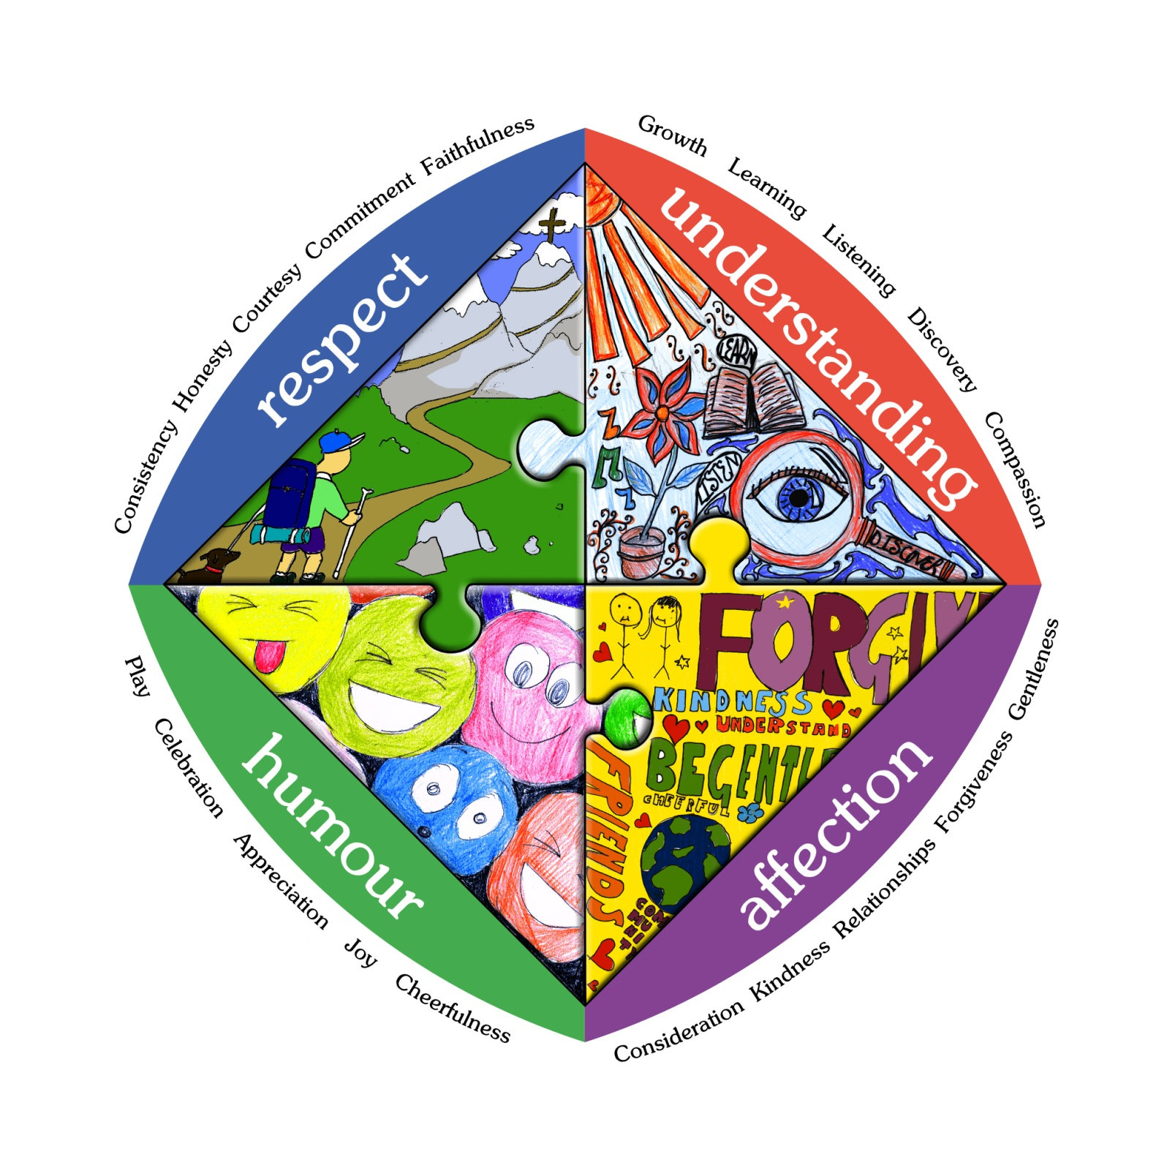
What does it mean to be Salesian?

Slide 3
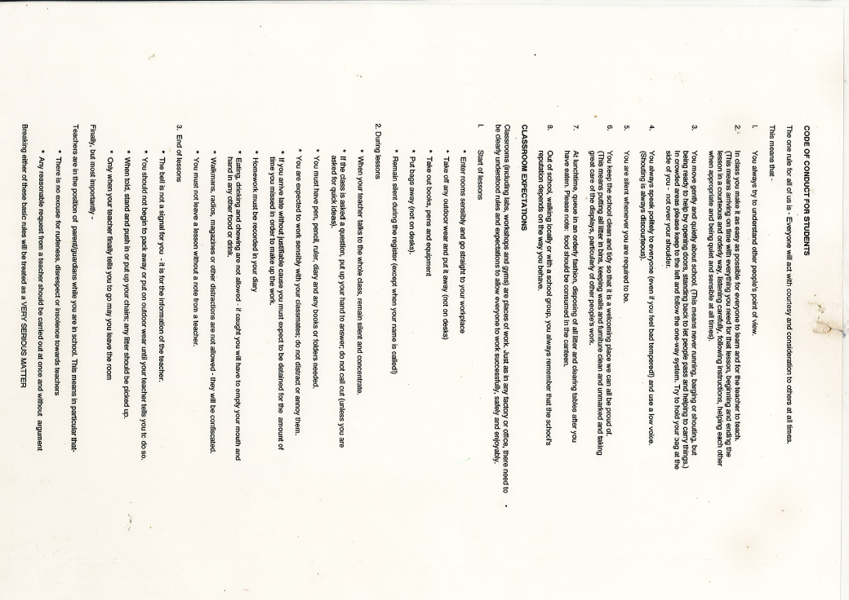

Slide 4

What does it mean to be Salesian?
What did he teach?
  Church
  School
  Home
  Playground
  Respect
  Understanding
  Affection
  Humour

Slide 5
What does it mean to be Salesian?
R
U
A
H
negativity
laziness
feuding
dishonesty
embarrassment
ingratitude
ignorance
selfishness
bullying
unreliability
indifference
gossip
rudeness
revenge
sadness
meanness
pessimism
depression
confusion
boredom
carelessness
violence
loneliness
resentment
cruelty
hate
favouritism

Slide 6
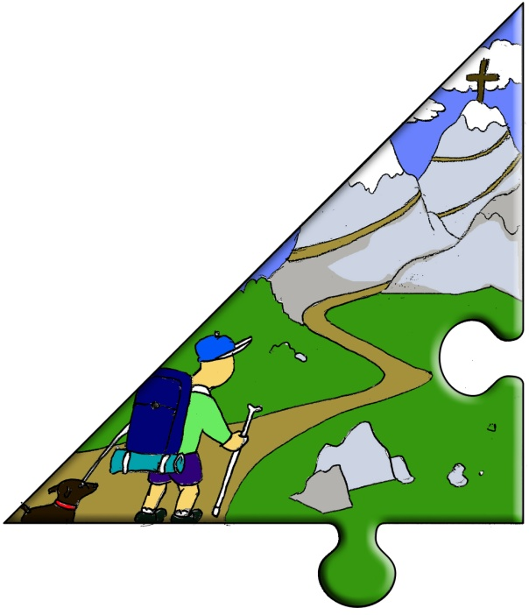
What does it mean to be Salesian?
Respect
Holding everyone in high regard
  Consistency
  Honesty
  Courtesy
  Commitment
  Faithfulness

Slide 7
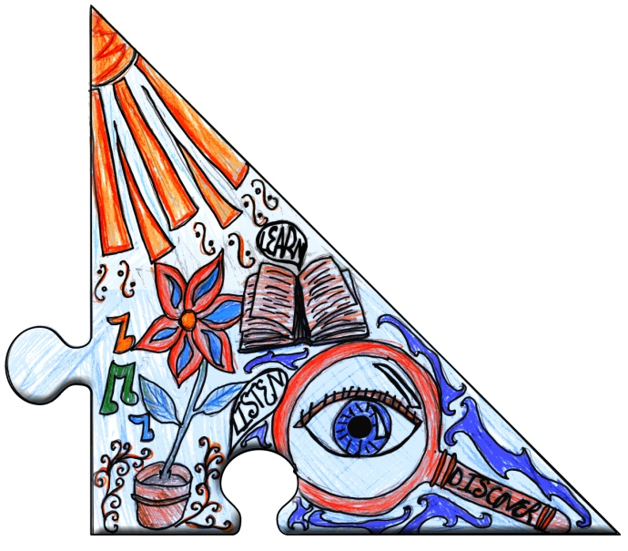
What does it mean to be Salesian?
Understanding
Our life-long learning journey
  Growth
  Learning
  Listening
  Discovery
  Compassion

Slide 8
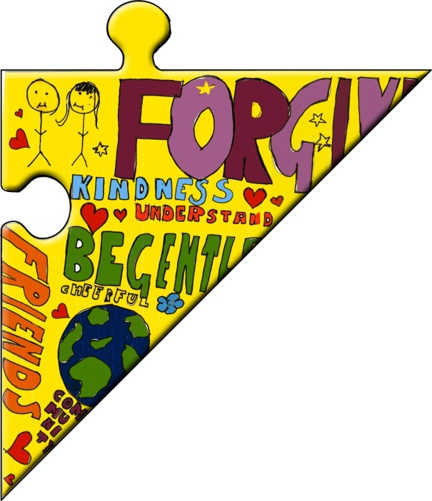
What does it mean to be Salesian?
Affection
Love makes the world go around
  Consideration
  Kindness
  Forgiveness
  Gentleness
  Strong relationships

Slide 9
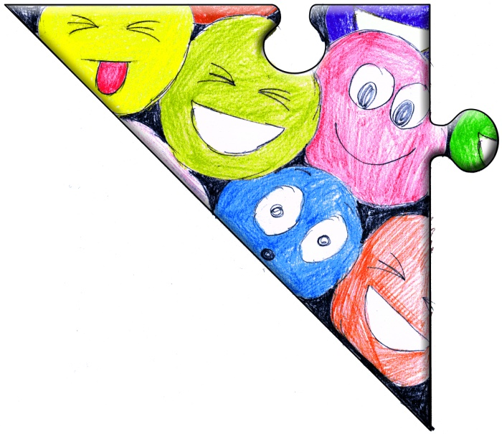
What does it mean to be Salesian?
Humour (and Happiness!)
In the right mood we can face anything!
  Play
  Celebration
  Appreciation
  Joy
  Cheerfulness

Slide 10

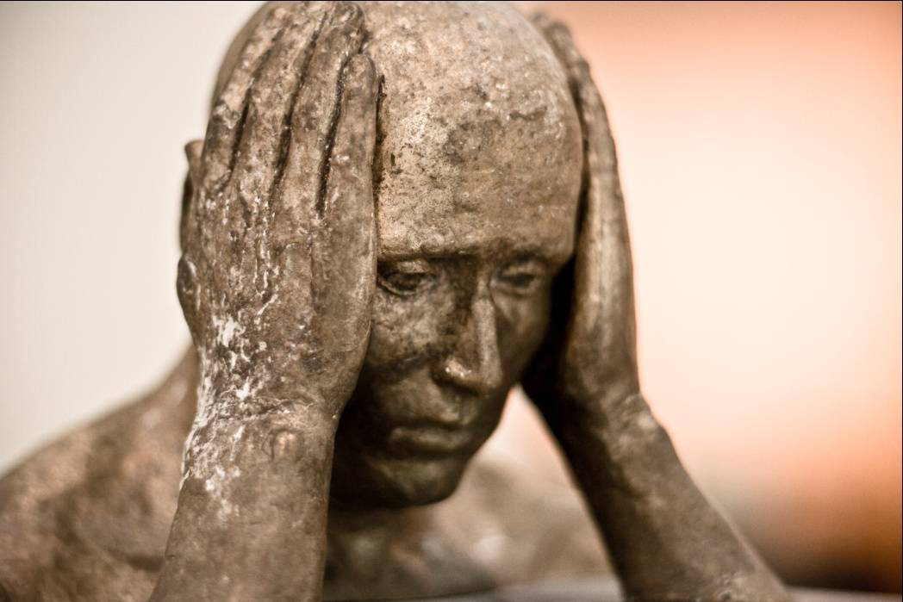

What does it mean to be Salesian?
Putting it into practice
A classmate’s having a tough time
Compassion
Cheerfulness
Kindness

Slide 11

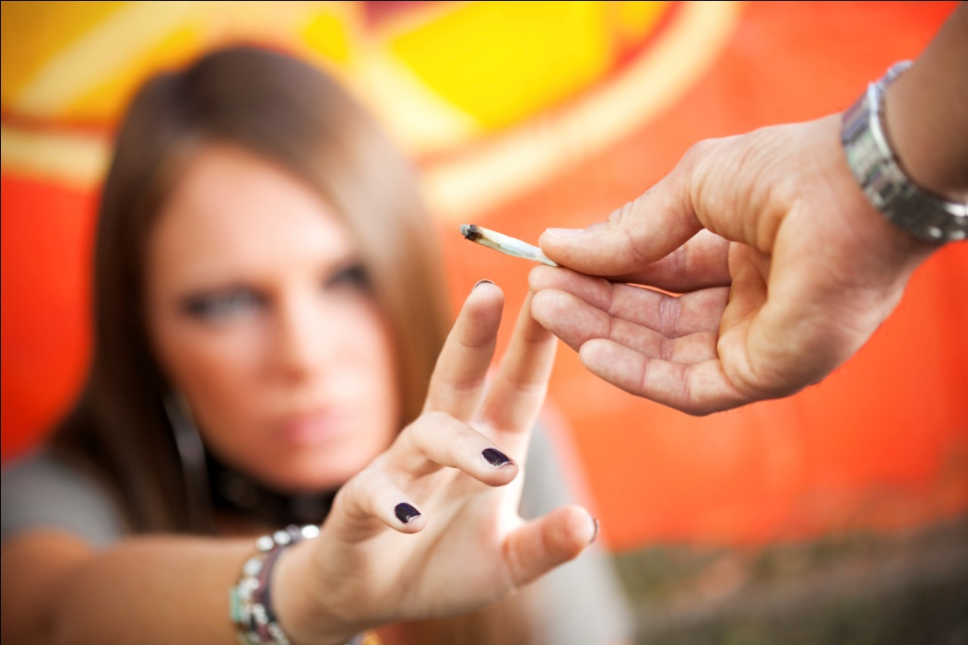
What does it mean to be Salesian?
Putting it into practice
Temptation from a friend
Faithfulness
Growth
Relationships

Slide 12
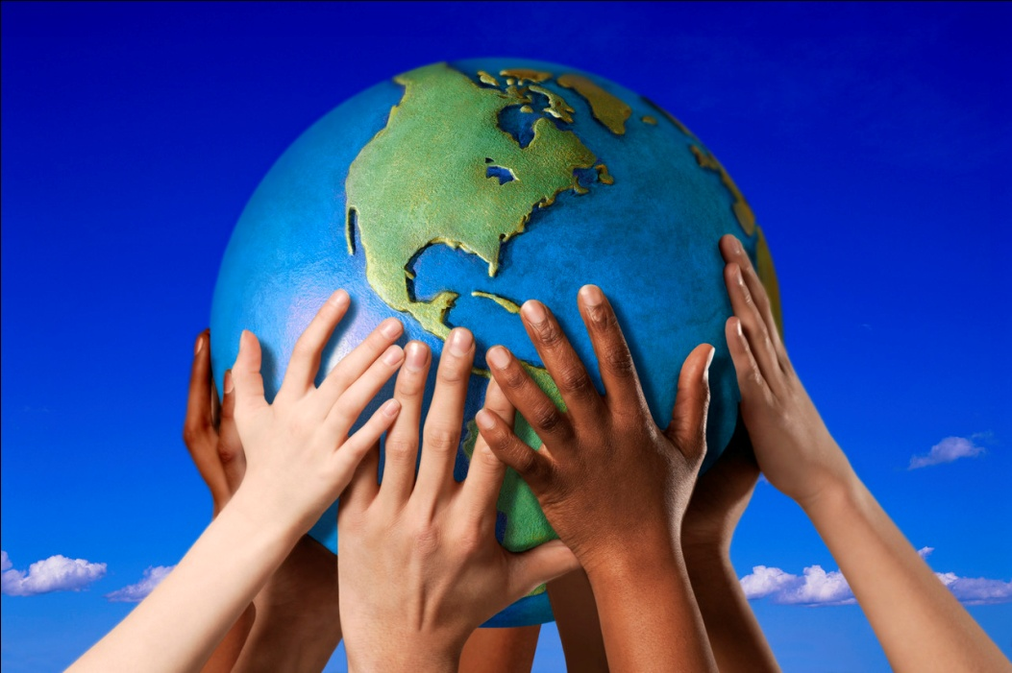
What does it mean to be Salesian?
Putting it into practice
Saving the world
Respect
Discovery
Celebration
Gentleness

Slide 13
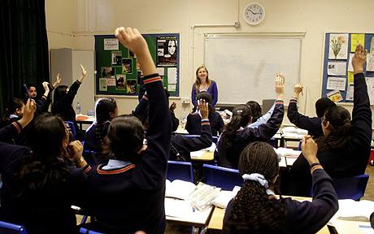
What does it mean to be Salesian?
Putting it into practice
In the classroom
Commitment
Learning
Appreciation
Consideration

Slide 14
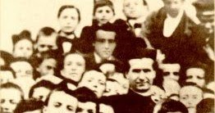
Caught, not taught
Notes:
Not a strategy, it’s a state of mind
Not like differentiation-people need to embody it-buy into it
How do we know that it has worked?
HoY interviews/prefect interviews/student panels

Slide 15
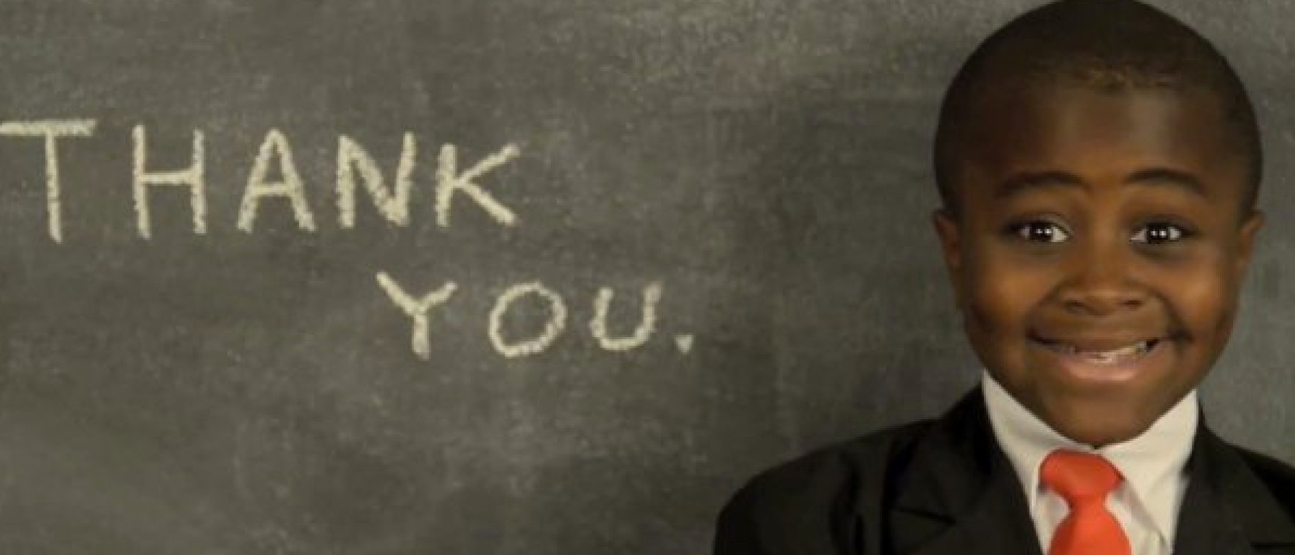
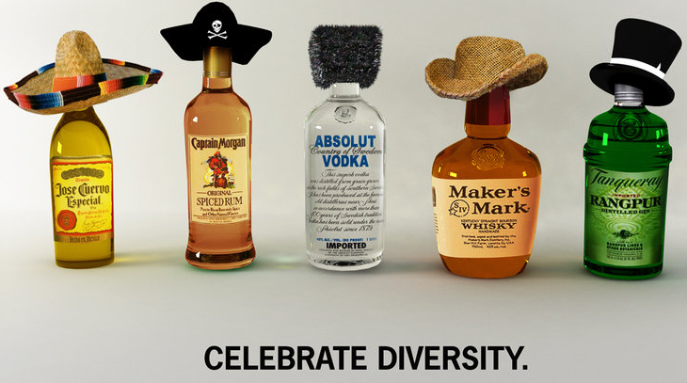

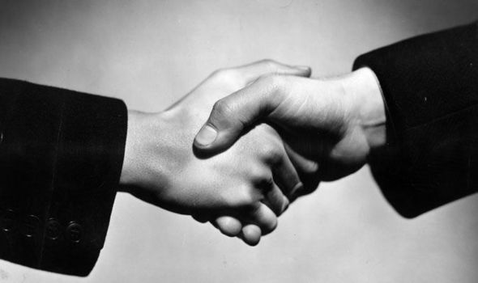
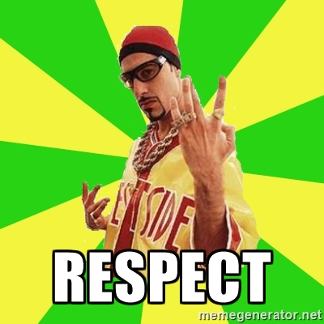

Notes:
For me respect is the most important element of RUAH and actually is the glue that binds ruah together. We do respect very well here; you can’t; walk across the yard without kids saying hi to you and they are never going to say no if you ask them to help you in any way. God created us all different, and variety really is the spice of life.
Without the attitude of celebrating diversity and respecting each other
For me respect goes beyond the physical things, its much more of an attitude and something that we hold deeper within us, in the way that we speak to each other and listen to each others opinions.
The only way we can keep our classrooms places where there is healthy debate is if we keep fostering the culture can have classrooms full of debate and healthy discussion is to respect each other’s opinions and create an atmosphere where. I think its so so important that we keep those basic elements of respect, please thank you and offering to help, as a minimum requirement in school. Let’s make it so that we expect respect.
It’s our job to nurture and foster classrooms which are full of healthy debate, discussion and intelligent differing of opinions, and this cant happen without the kids innate understanding and respect for one another, and respect for one and other’s ideas. For me personally, I wouldn’t be able to teach my subject without the kids tolerance for other people and other ideas.
That’s why for me, without respect, we would have school we have today. So its important to celebrate diversity, embrace your inner gook and keep telling the kids that its; ok to be different if you respect each other. And if it’s good enough for Kid President, and Ali G, then it’s definitely something that we can think about more as well! If respect can become Ali G’s catchphrase, then maybe we should start talking about it more and making it our catch phrase too…

Slide 16
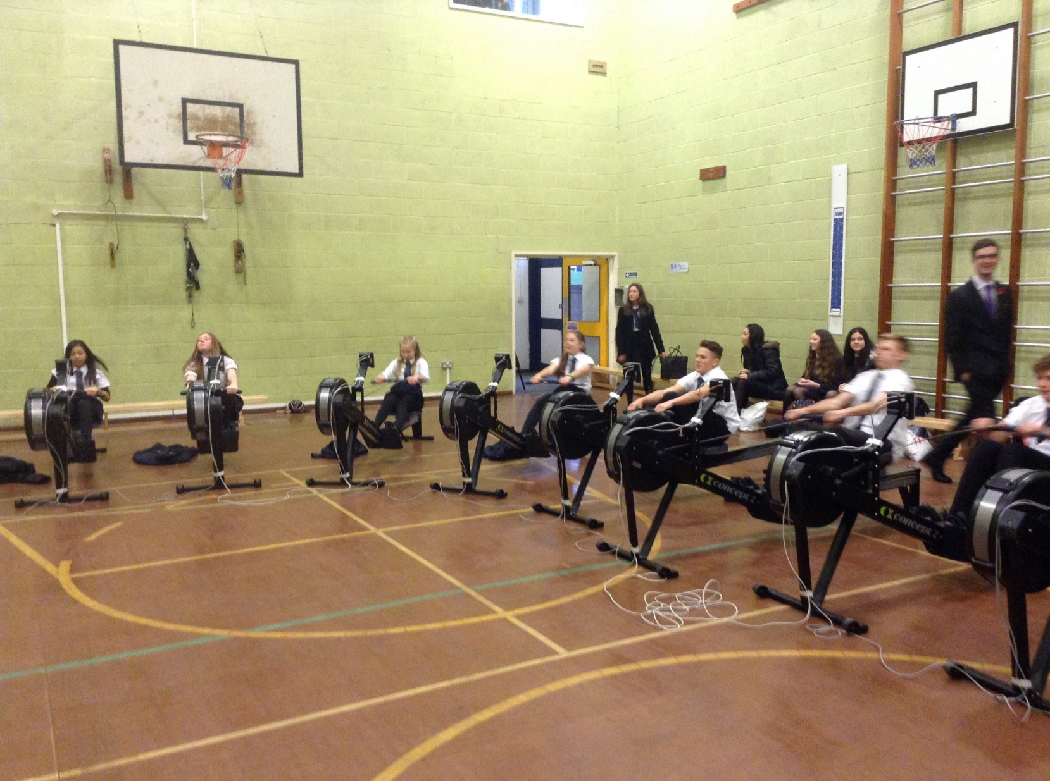
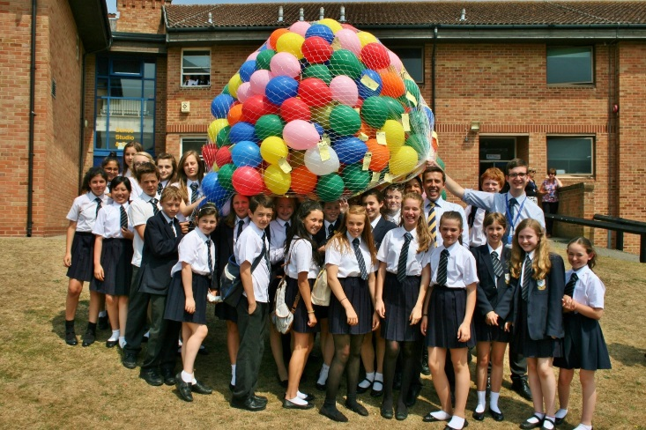
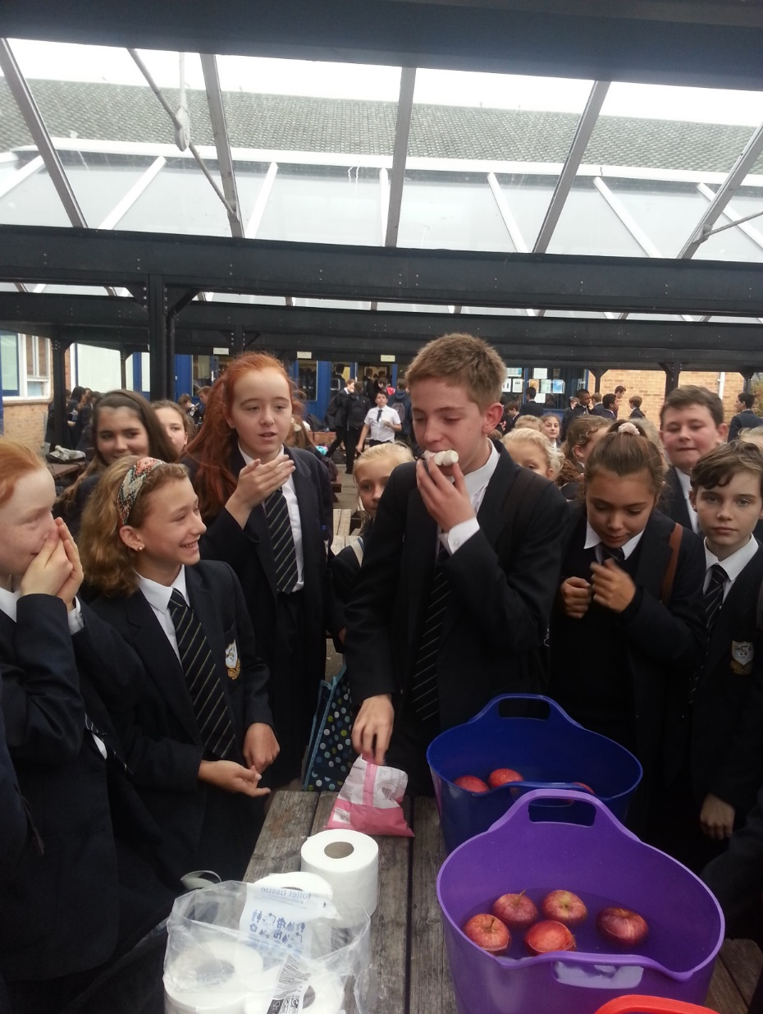
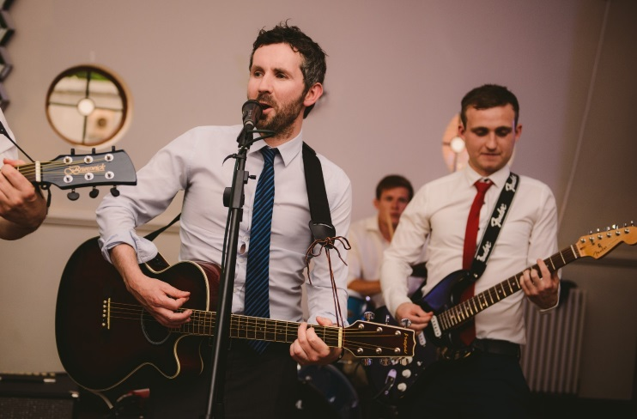
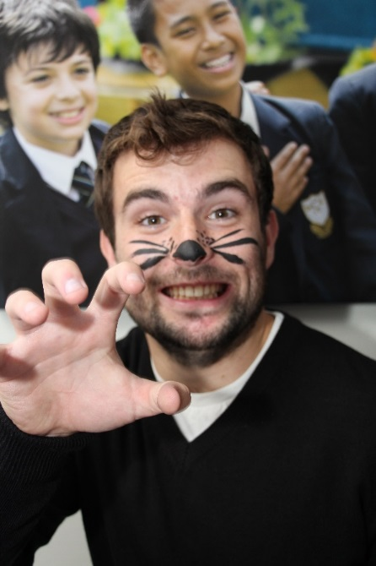
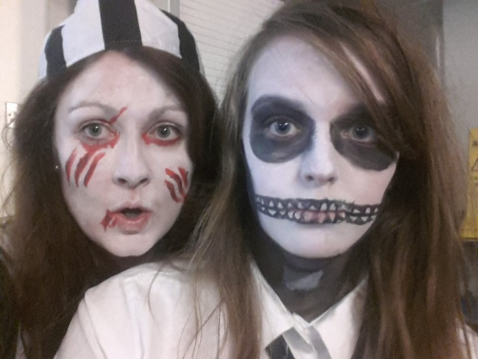
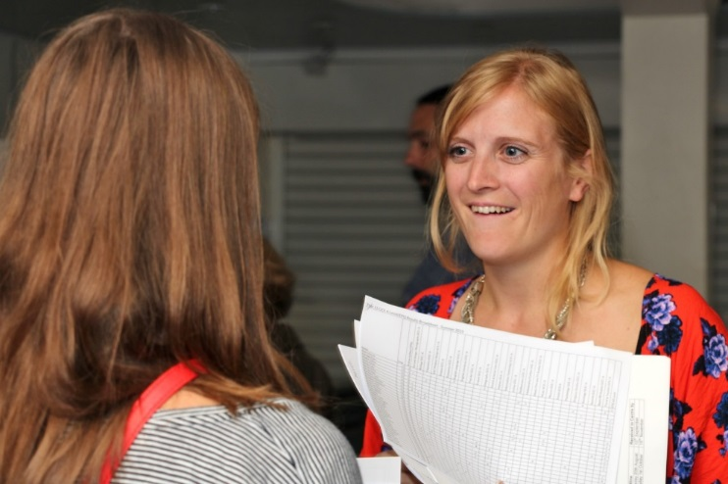
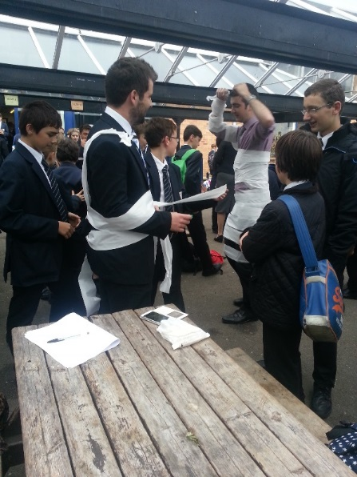
Affection
Synonyms: fondness, love, liking, endearment, feeling, sentiment, tenderness, warmth, warmness, devotion, care;
Stable Relationships
The yard
Extra Curricular
Each lesson

Slide 17

Understanding

Slide 18
To Boil it down to 4…..
To understand is to grasp the significance of something.
To understand significance you must reflect on events, accidents and opportunities
Understanding is not about management of surface events but discerning the deeper currents of the spirit and the way that the spirit needs to be set free.
Understanding the limitations, thoughtlessness and immaturity of young people can help establish reasonable expectations that stretch their growth but never set them up to fail.

Slide 19
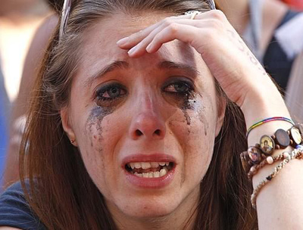
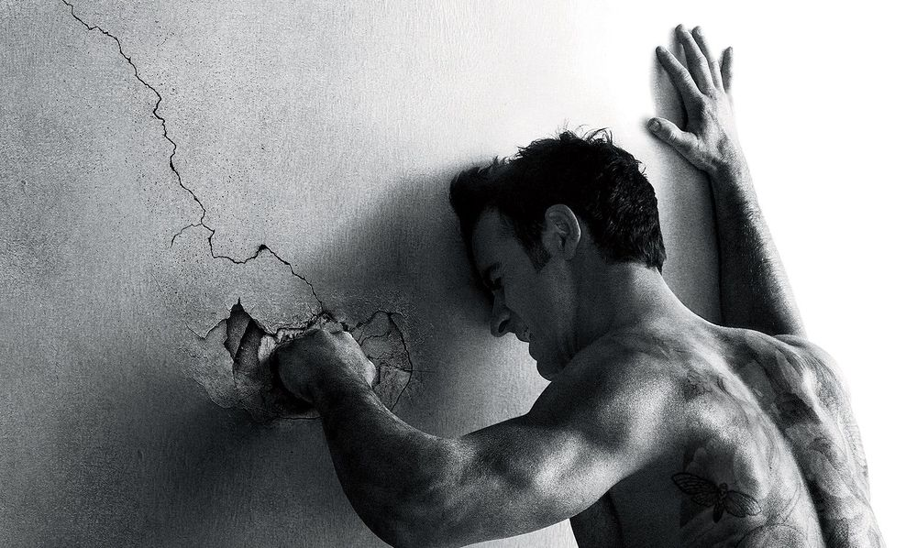
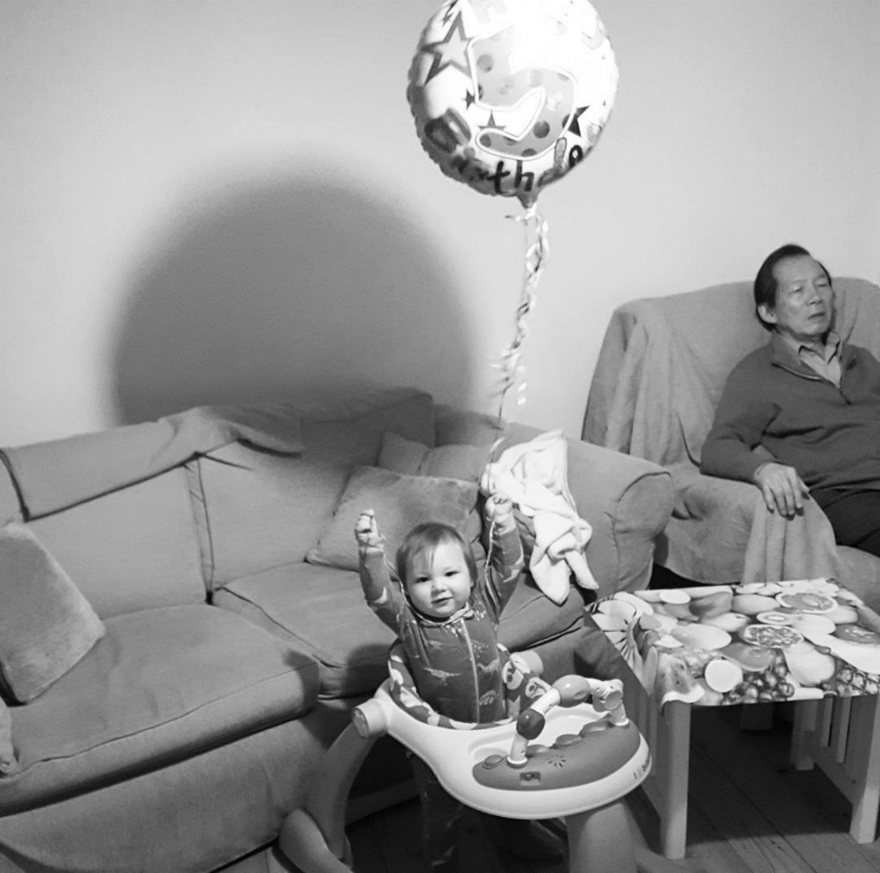
Examples

Slide 20
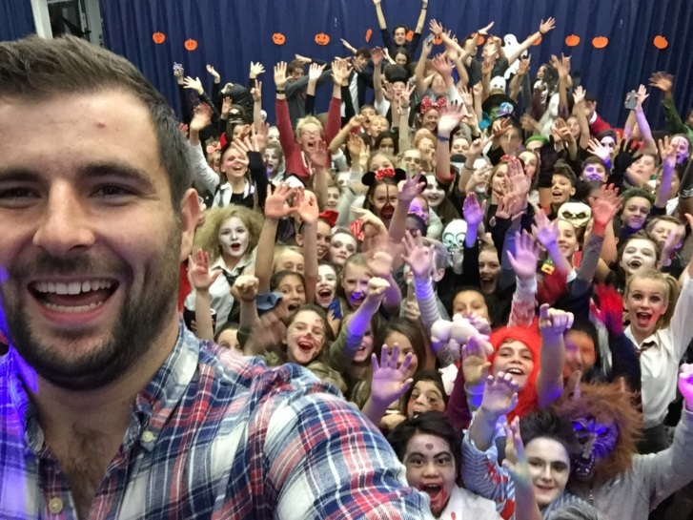
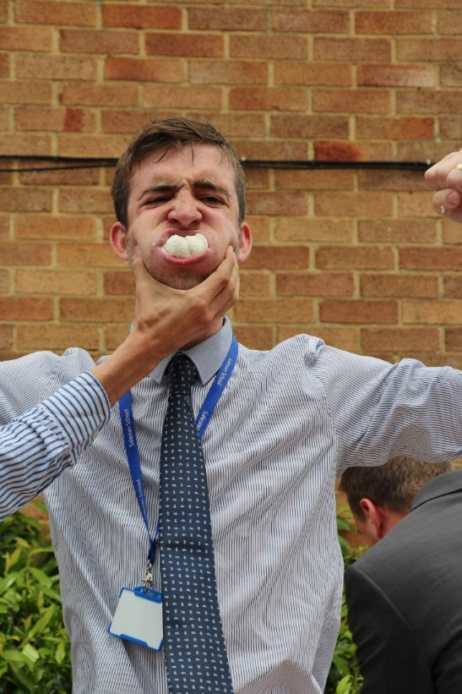
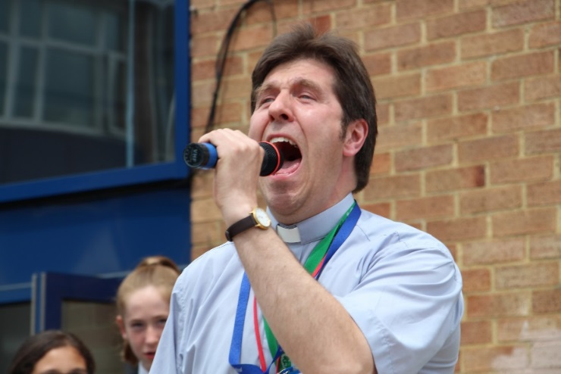
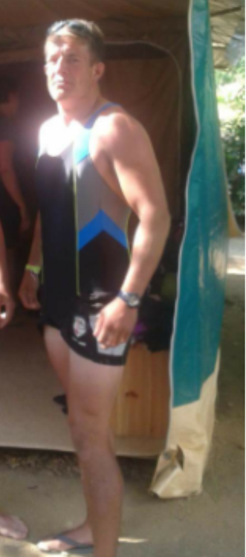
Meet the students on the playground
Notes:
House events
Kids see you in a different light, you become more personable, humanised!

Slide 21
Key Vocabu-lol-ary
Lolz.
“Laugh out loud”
“That was bantz”
“That was funny”
“Bare sick”
“That was really good”

Slide 22
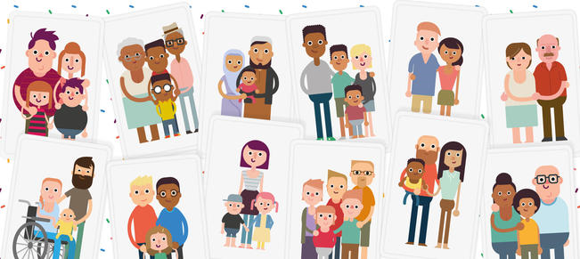
Our Community
Notes:
Information Evenings
What does it look like?
Reward systems
Part of our vernacular

Slide 23
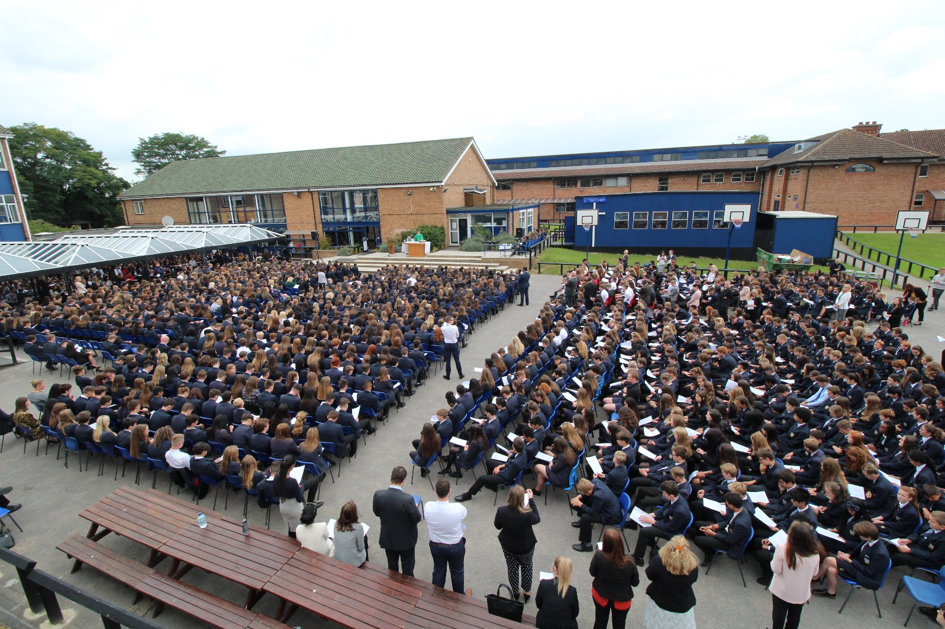
What does it look like?
Notes:
Picture Competition
Posters in every classroom
HoY Awards
Staff awards
Language
Heads Message
Assembly Rota
Induction of new staff
Tutor Time

Slide 24
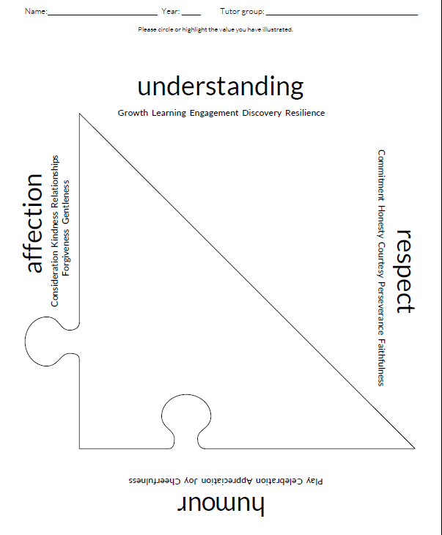

Slide 25
What does it look like?
Notes:
Picture Competition
Posters in every classroom
HoY Awards
Staff awards
Language
Heads Message
Assembly Rota
Induction of new staff
Tutor Time

Slide 26
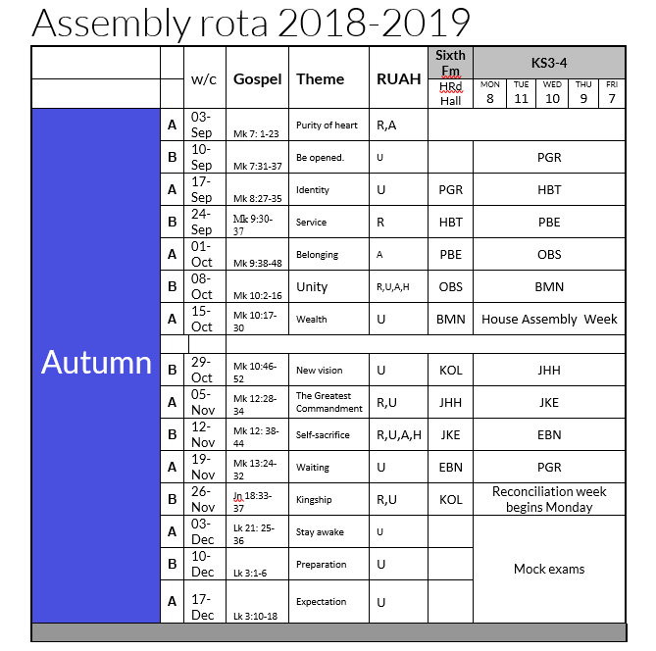

Slide 27
What does it look like?
Notes:
Picture Competition
Posters in every classroom
HoY Awards
Staff awards
Language
Heads Message
Assembly Rota
Induction of new staff
Tutor Time

Slide 28
Transitions and planning ahead: Preparing for Year 8 2016-2017
EXAMPLE
R | What aspect of your personality needs a bit of work? How could you improve yourself over the summer to make your experience better? | e.g. confidence, assertiveness, jumping to conclusions, putting yourself in other people’s shoes Stop asking for reassurance
U | What one specific thing could you do to change your mind set? Identify one thing you are going to be a master of over the summer? | e.g. using commas in a paragraph, drawing 3-D shapes, periodic table, cave formation, what are the sacraments? Learning the guitar and re-learning the piano
A | How could you help your community? What could you do to continue to practise your Salesian values over the summer? | e.g. volunteer in a charity shop for a day, help someone with their shopping, reconciliation, attend Mass Walking Hadrian's Wall for charity- 84 miles Coast to coast
H | What are you going to do to ensure your happiness? What are you going to do to rest and enjoy the time over the summer to prepare for the year 8? | e.g. learn a new trick , going somewhere new? Favourite movie, reading Grand Canyon!!!!!!
PLEASE SAVE YOUR FORM INTO YOUR TUTOR FOLDER in S:\Students\Year 8 SCB BY MONDAY 18TH JULY

Slide 29

Notes:
House Competitions
Staff Well being

Slide 30
Theme of the week: Trinity

Slide 31
What is RUAH?
This week we celebrate the feast of Pentecost, commonly seen as the birth of the Church when those same disciples received the Holy Spirit and were blessed with (amongst other things) the understanding and courage to go out into the world and profess all that they had learned during their time with Jesus. All of us who have been baptised have received these gifts and whilst, unlike the disciples, we may not have tongues of fire flickering over our heads or be blessed with the ability to speak another language, we all have the potential to share the message of the Gospel. The same is true for all the children at Salesian.
Staff and students alike live by four central Salesian principles, summed up in the word RUAH, which is Hebrew for Breath of God, or Spirit. They are:
Respect - for oneself, and others, and every opportunity
Understanding - a commitment to learning and working well with others
Affection - care and love for each other, always
Happiness and Humour - Don Bosco loved to make people laugh

Slide 32
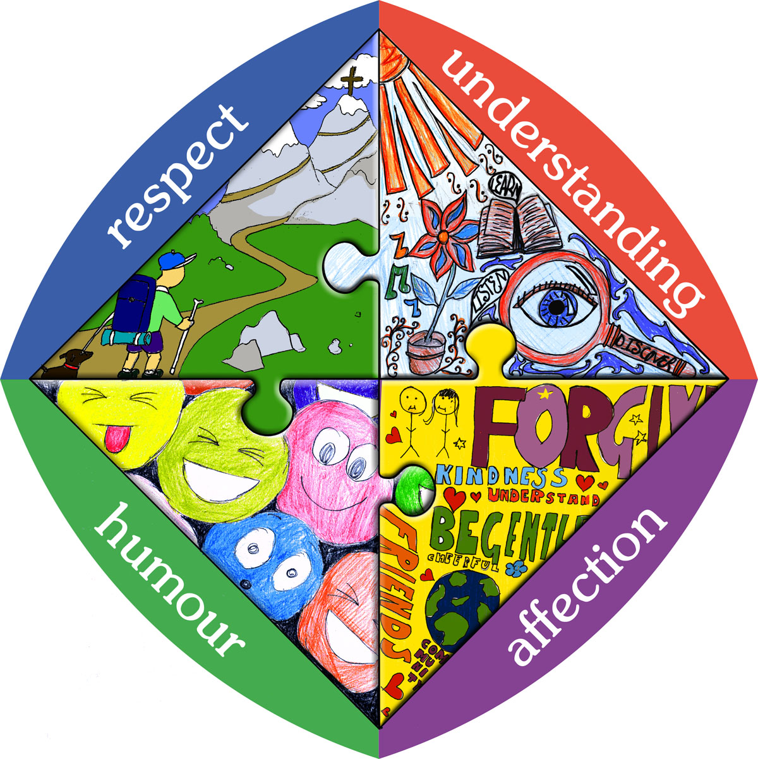
Commitment
Perseverance
Faithfulness
Courtesy
Honesty
Engagement
Learning
Resilience
Discovery
Growth
Joy
Play
Celebration
Appreciation
Cheerfulness
Kindness
Gentleness
Forgiveness
Relationships
Consideration

Slide 33
Discussion point: People’s feelings can be fragile, like an egg; treat others kindly and considerately, showing respect for their feelings.
This activity needs to be done in an outdoor area or on a washable surface, as it can get messy.
Begin by passing a raw egg back and forth between two people or around in a circle. Keep backing up and increasing the distance of the toss. The egg may or may not break.
Use this game as an opportunity to talk about how we must treat others with respect. Explain that people are fragile like the egg. Humans don’t have shells, but people can have very sensitive feelings and it’s our job to seek to understand the feelings of others.. Treating others with consideration demonstrates respect for their feelings.
The game can also be used as a reminder to care for the family home and possessions and for the things that others own.
Questions for discussion
How do you feel when someone speaks harshly to you?
What do people say to hurt the feelings of other people?
Do you think it makes God sad or mad when people hurt each other?

Slide 34
How can we show respect and understanding?
You’re a Salesian now. Think it. Live it. Act it.
https://www.youtube.com/watch?v=m5yCOSHeYn4

Slide 35
Humour and Affection
Joy
Play
Celebration
Appreciation
Cheerfulness
Kindness
Gentleness
Forgiveness
Relationships
Consideration
Joy, love, kindness and gentleness are all fruits of the Holy Spirit.

Slide 36
Affection
“It is only when we engage with the heart that the best learning happens.”
Fr David O’Malley

Slide 37
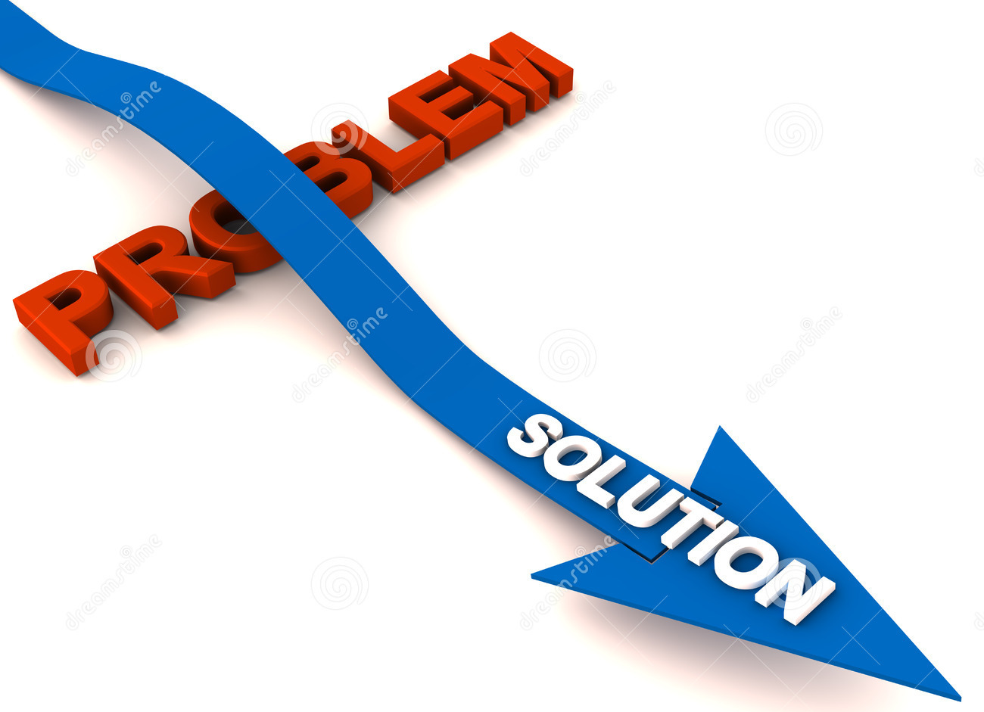
Affection in Salesian
With a bit of:
Kindness
Gentleness
Forgiveness
Relationships
Consideration
We can overcome:
Cruelty, unkindness
Rudeness, greed, violence
Resentment, revenge
Loneliness, bullying, pecking orders
Thoughtlessness, selfishness

Slide 38
Affection in the Bible
John 13:34-35
A new command I give you: Love one another. As I have loved you, so you must love one another. By this all men will know that you are my disciples, if you love another.

Slide 39
Humour
“Pessimism can be overcome by the perspective of a cheerful and humble heart.”
Fr David O’Malley

Slide 40
Humour in Salesian
With a bit of:
Joy
Play
Celebration
Appreciation
Cheerfulness
We can overcome:
Sadness
Anxiety, stress, tension
The feeling of being ignored
Favouritism, ingratitude
Negativity, worry, fear,

Slide 41
Humour and Happiness in the Bible
Psalm 100:1-5
“Shout for joy to the LORD, all the earth.
Worship the LORD with gladness; come before him with joyful songs…”

Slide 42
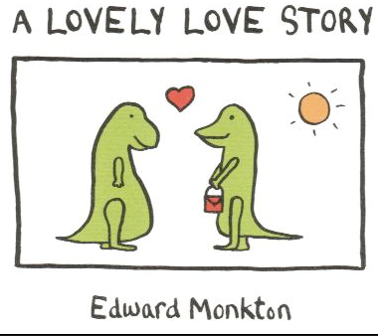
Can you spot the features of RUAH in this little tale?

Slide 43
The Dinosaur Love Poem
The fierce Dinosaur was trapped inside his cage of ice.
Although it was cold he was happy in there. It was, after all, his cage.
Then along came the Lovely Other Dinosaur.
The Lovely Other Dinosaur melted the Dinosaur’s cage with kind words and loving thoughts.
I like this Dinosaur thought the Lovely Other Dinosaur.
Although he is fierce he is also tender and he is funny.
He is also quite clever though I will not tell him this for now.
I like this Lovely Other Dinosaur, thought the Dinosaur.
She is beautiful and she is different and she smells so nice.
She is also a free spirit which is a quality I much admire in a dinosaur.
But he can be so distant and so peculiar at times, thought the Lovely Other Dinosaur. He is also overly fond of things. Are all Dinosaurs so overly fond of things?
But her mind skips from here to there so quickly thought the Dinosaur.
She is also uncommonly keen on shopping. Are all Lovely Other Dinosaurs so uncommonly keen on shopping?
I will forgive his peculiarity and his concern for things, thought the Lovely Other Dinosaur. For they are part of what makes him a richly charactered individual.
I will forgive her skipping mind and her fondness for shopping, thought the Dinosaur. For she fills our life with beautiful thoughts and wonderful surprises. Besides, I am not unkeen on shopping either.
Now the Dinosaur and the Lovely Other Dinosaur are old.
Look at them. Together they stand on the hill telling each other stories and feeling the warmth of the sun on their backs.
And that, my friends, is how it is with love. Let us all be Dinosaurs and Lovely Other Dinosaurs together. For the sun is warm. And the world is a beautiful place.

Slide 44
Discuss
What aspects of RUAH apply to this poem?
- Go through each one and find qualities
What aspects of RUAH have your teachers demonstrated so far this term?
What aspects of RUAH have you demonstrated to your friends? Teachers?

